Slide 1

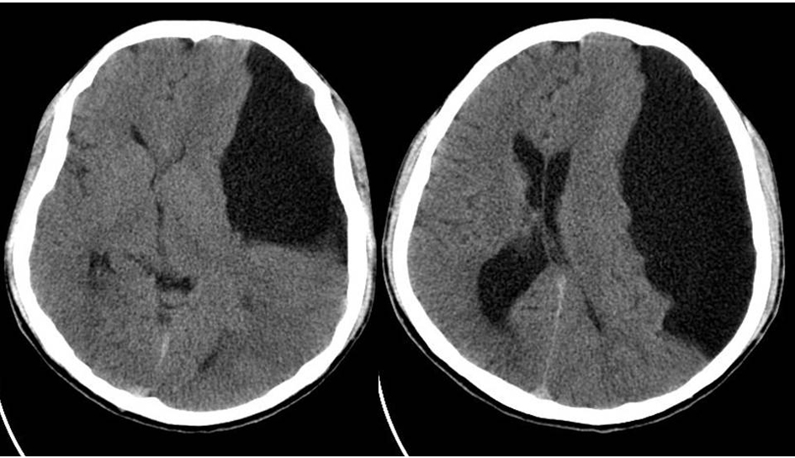
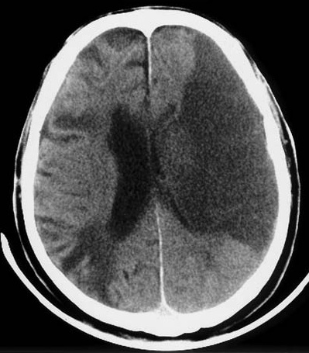
Hypodense lesion in CT brain
Dr. Aminur Rahman
FCPS (Med), MD(Neuro) ,FINR (Switzerland), MACP (USA)
Fellow Interventional Neuroradiology (Thailand)
Assistant Professor
Department of Neurology
Sir Salimullah Medical College

Slide 2
Learning objects
Hypodense lesion in brain
Infarct
Old hemorrhage
Cystic lesion in brain
Oedema
Hydrocephalus
ICSOL
CNS infection
Air, e.g., In nasal cavity, paranasal sinuses

Slide 3
A. Infarct

Slide 4
Schematic presentations of blood supply of brain

Slide 5
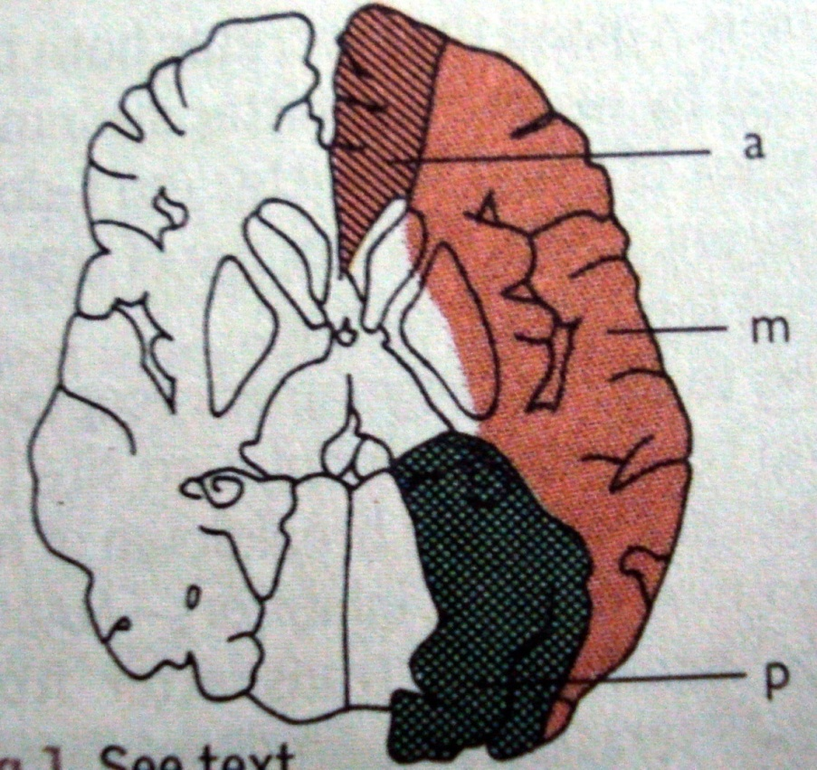
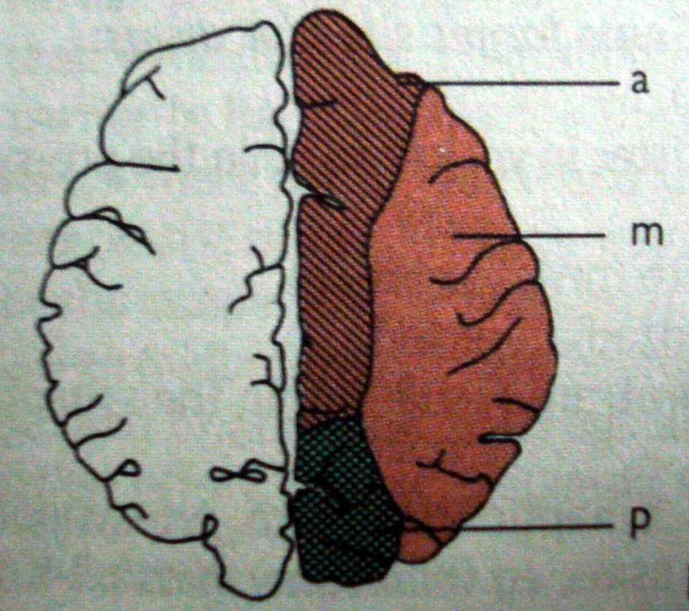
Vascular territory of brain
a- Anterior cerebral artery
m- Middle cerebral artery
p-Posterior cerebral artery

Slide 6
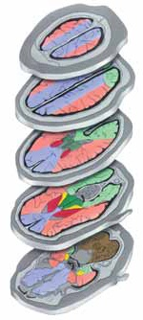
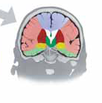
Blue colour – ACA: Ant. Cerebral artery territory.
Pink & Red colour – MCA: Middle cerebral artery territory.
Green colour – PCA: Posterior cerebral artery territory.

Slide 7
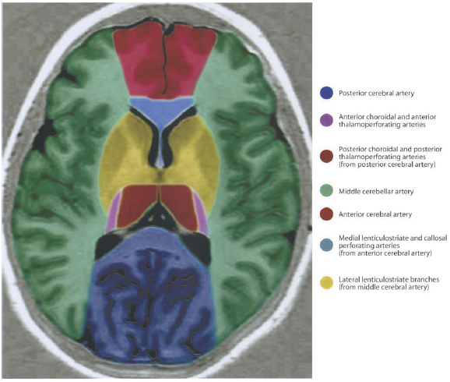

Slide 8
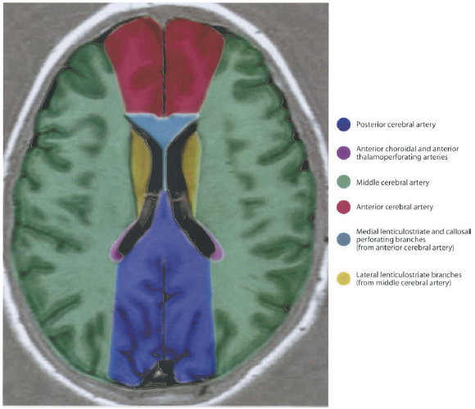

Slide 9
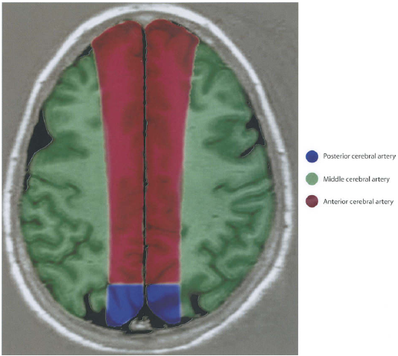

Slide 10
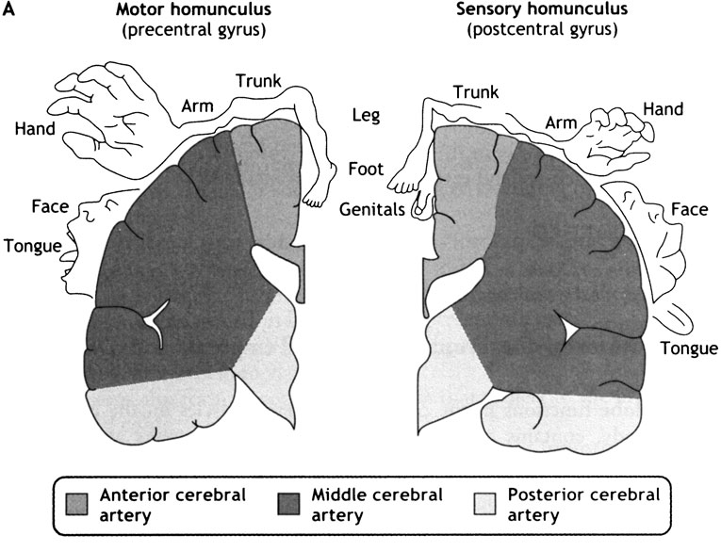
Functional areas of brain

Slide 11
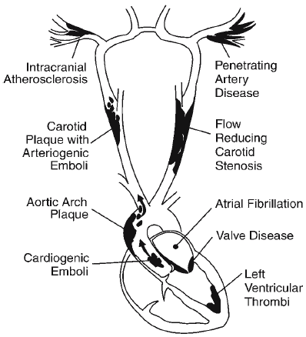
Sources of embolism

Slide 12
Time course of ischemic stroke on CT

Slide 13
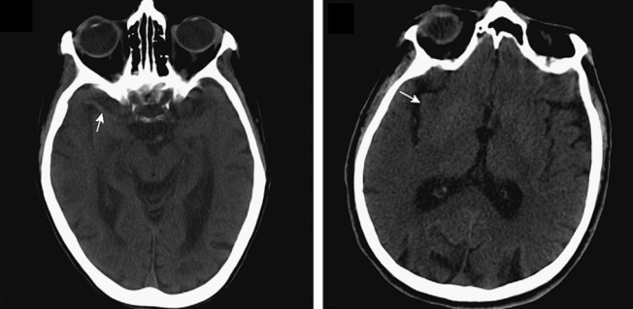
Ischemic stroke on CT
Immediate(< 3 hours):
Figure: This is a multi slice axial plan CT scan of the head showing the early CT sign (<6h) of ischemic stroke with hyperdensity of MCA representing an acute embolus lodged into it (left) known as “hyperdense MCA sign”.

Slide 14
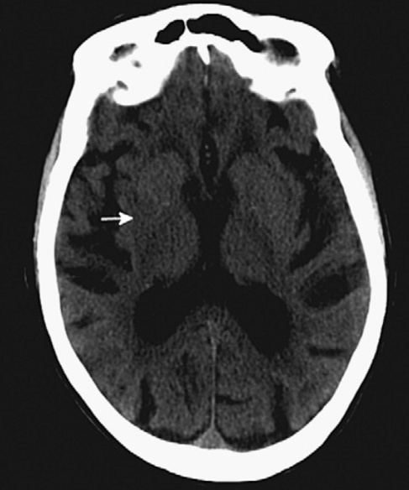
Figure: This is a multi slice axial plan CT scan of the head showing the early CT sign (<6h) of ischemic stroke with “loss of gray-white matter differentiation” in basal ganglia.
Ischemic stroke on CT
Immediate:

Slide 15

Early hyperacute: ˃3–12 hours
Ischemic stroke on CT
Figure: This is a multi slice axial plan CT scan of the head showing the early CT sign (<6h) of ischemic stroke with a “diffuse cerebral swelling with loss of cortical sulci and compression of ventricular system” (right).

Slide 16

Figure: This is a multi slice axial plan CT scan of the head showing the hypodensity of insular cortex known as “insular ribbon sign”.
Ischemic stroke on CT
Early hyperacute : ˃3–12 hours

Slide 17
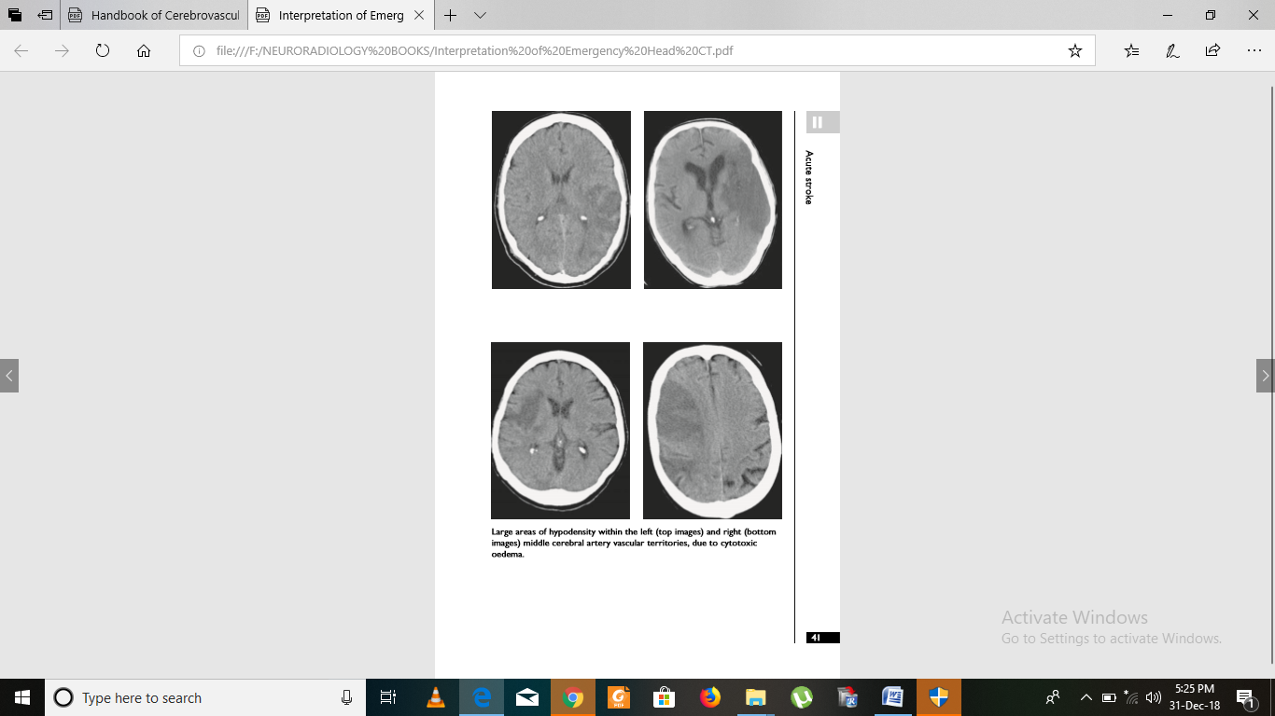
Acute: 12 hours -7 days
Ischemic stroke on CT
Figure: Axial plan CT scan of the head shows large areas of hypodensity in the left cerebral hemisphere due to occlusion of left middle cerebral artery vascular territories.

Slide 18
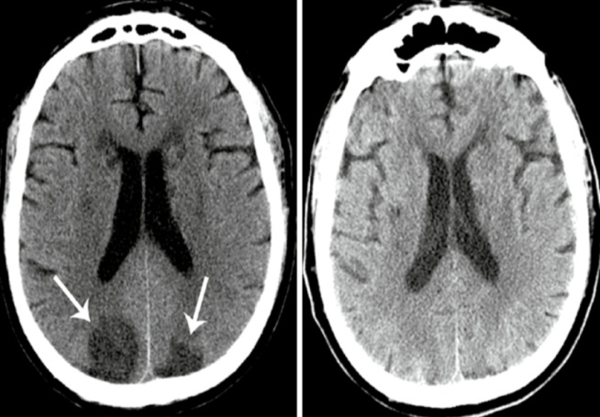
Subacute:1 -2 weeks
Ischemic stroke on CT
Figure: This is a multi slice axial plan CT scan of the head showing the “fogging effect” occurs during subacute phase.
Left CT image is obtained at 36hr with bilateral occipital hypodensities.
Right CT image is taken at 18 days showing the isodense appearance of previous infarct.

Slide 19
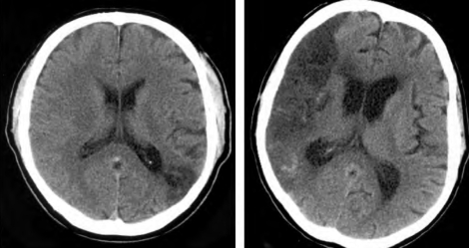
Chronic: ≥4 weeks– months
Ischemic stroke on CT
Figure: This is a multi slice axial plan CT scan of the head of ischemic stroke demonstrating various location of ischemic stroke at chronic phase, showing the encephalomalacia

Slide 20
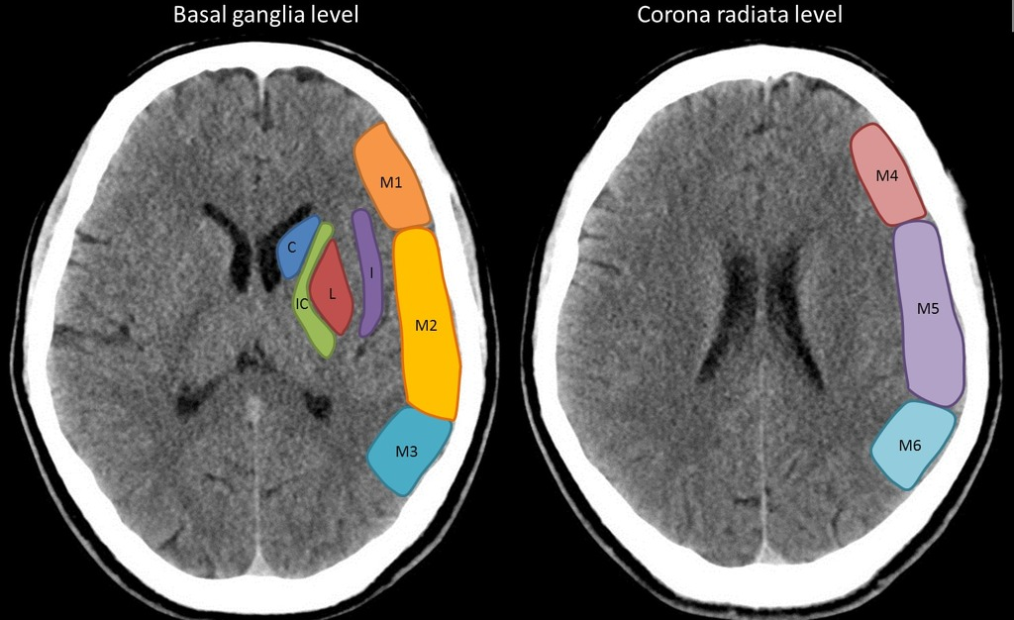
Alberta stroke program early CT score (ASPECTS)
Middle cerebral artery (MCA) vascular territory
C-Caudaate.IC- Internal capsule,L-Lentiform nucleus, I-insular cortex

Slide 21
Alberta stroke program early CT score (ASPECTS)
Segmental assessment of the MCA vascular territory is made and 1 point is deducted from the initial score of 10 for every region involved:
Caudate
Putamen
Internal capsule
Insular cortex
M1: "anterior MCA cortex," corresponding to frontal operculum
M2: "MCA cortex lateral to insular ribbon" corresponding to
anterior temporal lobe
M3: "posterior MCA cortex" corresponding to posterior
temporal lobe
M4: "anterior MCA territory immediately superior to M1"
M5: "lateral MCA territory immediately superior to M2"
M6: "posterior MCA territory immediately superior to M3

Slide 22
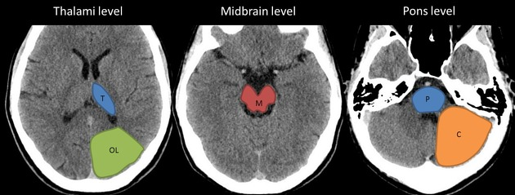
Alberta stroke program early CT score (ASPECTS)
Posterior circulation - Alberta stroke program early CT score (pc-ASPECTS)
T-Thalamus, OL-Occipital lobe, M-any part of Midbrain, P- any part of Pons, C- Cerebellar hemisphere

Slide 23
Posterior circulation - Alberta stroke program early CT score (pc-ASPECTS)
Variations of the ASPECT scoring system have been described for use in the posterior circulation and referred to as pc-ASPECTS
  Thalami (1 Point Each)
  Occipital Lobes (1 Point Each)
  Midbrain (2 Points)
  Pons (2 Points)
  Cerebellar Hemispheres (1 Point Each)

Slide 24
Clinical use of ASPECTS
It has been used to prognosticate for example the score is a strong predictor of functional outcome.
  An ASPECTS score less than or equal to 7 predicts a worse functional outcome at 3 months as well as symptomatic haemorrhage.
It has also been used to direct therapies.
  ASPECTS score more than 8 treated with thrombolysis with a good clinical outcome.
  Low ASPECTS score suggesting large MCA treated with intra-arterial treatments increases the risk of haemorrhage.

Slide 25
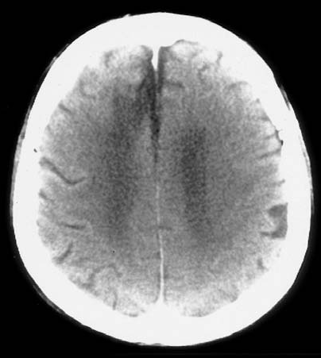
ACA territory infarct
This is a non contrast axial plan CT scan of head showing a hypo dense shadow in right frontal lobe.
So, my radiological diagnosis is infarct in right anterior cerebral artery territory.
Q: 1. What is the probable cause of this infarct ?
2. What will be the clinical features ?
3. Further investigations?
4. Treatment plan.

Slide 26
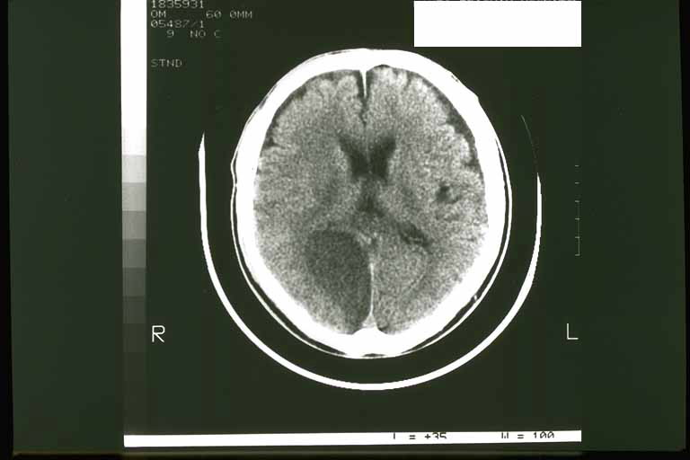
PCA territory infarct
This is a non contrast axial plan CT scan of head showing a hypo dense shadow in right occipital lobe.
So, my radiological diagnosis is infarct in right posterior cerebral artery territory.
Q: 1. What is the probable cause of this infarct ?
2. What will be the clinical features ?
3. Further investigations?
4. Treatment plan.

Slide 27
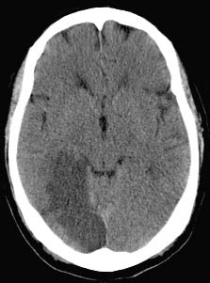
PCA territory infarct
This is a non contrast axial plan CT scan of head showing a hypo dense shadow in right parietal lobe.
So, my radiological diagnosis is infarct in right posterior cerebral artery territory
Q: 1. What is the probable cause of this infarct ?
2. What will be the clinical features ?
3. Further investigations?
4. Treatment plan.

Slide 28
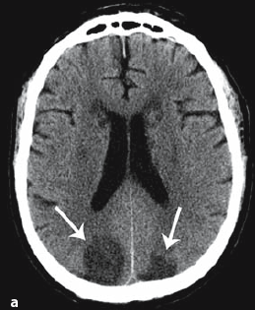
PCA territory infarct
This is a non contrast axial plan CT scan of head showing a hypo dense shadow in right parietal lobe.
So, my radiological diagnosis is infarct in Bilateral posterior cerebral artery territory
Q: 1. What is the probable cause of this infarct ?
2. What will be the clinical features ?
3. Further investigations?
4. Treatment plan.

Slide 29
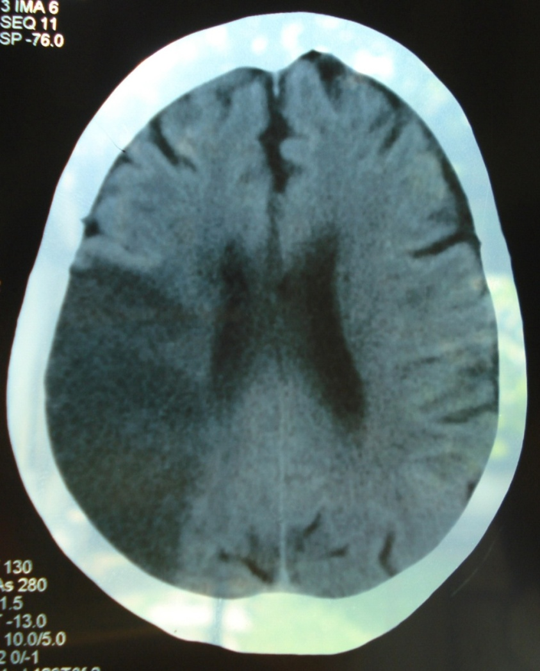
MCA territory infarct
This is a non contrast axial plan CT scan of head showing a hypo dense shadow in right parietal lobe.
So, my radiological diagnosis is infarct in right middle cerebral artery territory.
Q: 1. What is the probable cause of this infarct ?
2. What will be the clinical features ?
3. Further investigations?
4. Treatment plan.

Slide 30
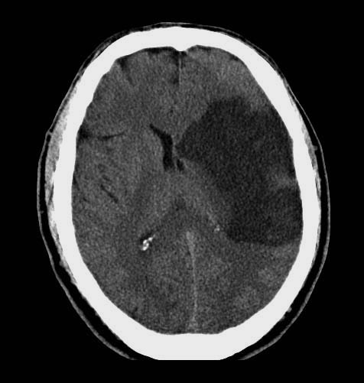
MCA territory infarct
This is a non contrast axial plan CT scan of head showing a hypo dense shadow in left parietal lobe.
So, my radiological diagnosis is infarct in left middle cerebral artery territory
Q: 1. What is the probable cause of this infarct ?
2. What will be the clinical features ?
3. Further investigations?
4. Treatment plan.

Slide 31
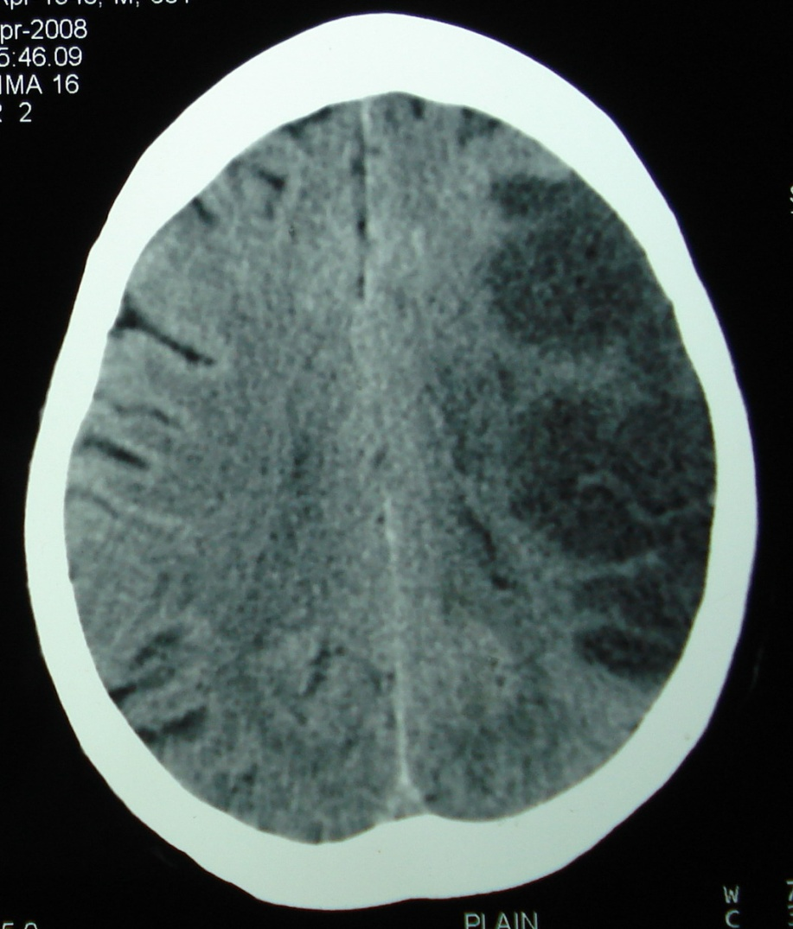
MCA territory infarct
This is a non contrast axial plan CT scan of head showing a hypo dense shadow in left parietal lobe.
So, my radiological diagnosis is infarct in left middle cerebral artery territory.
Q: 1. What is the probable cause of this infarct ?
2. What will be the clinical features ?
3. Further investigations?
4. Treatment plan.

Slide 32
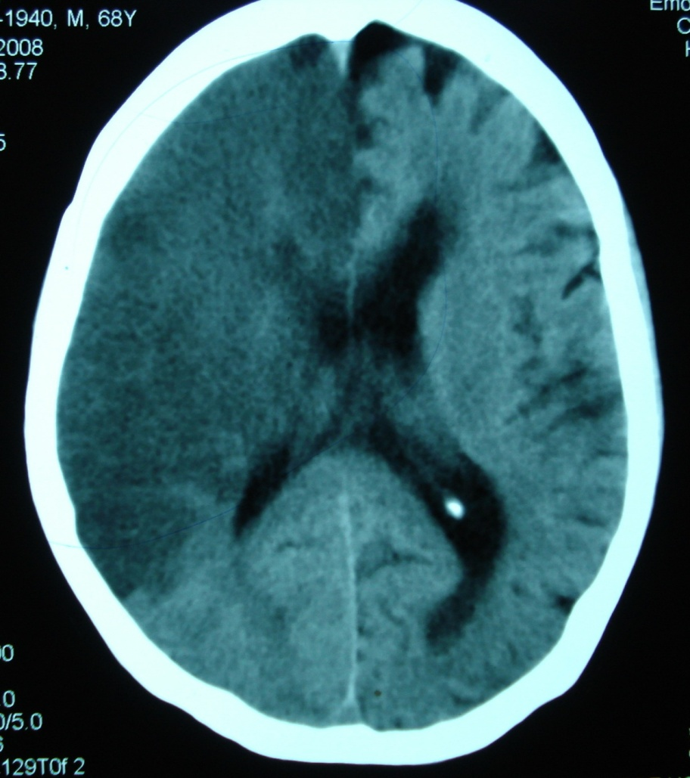
ACA & MCA territory infarct
This is a non contrast axial plan CT scan of head showing a hypo dense shadow in right fronto-parietal lobe.
So, my radiological diagnosis is infarct in right anterior & middle cerebral artery territory.
Q: 1. What is the probable cause of this infarct / site of lesion?
2. What will be the clinical features ?
3. Further investigations?
4. Treatment plan.

Slide 33
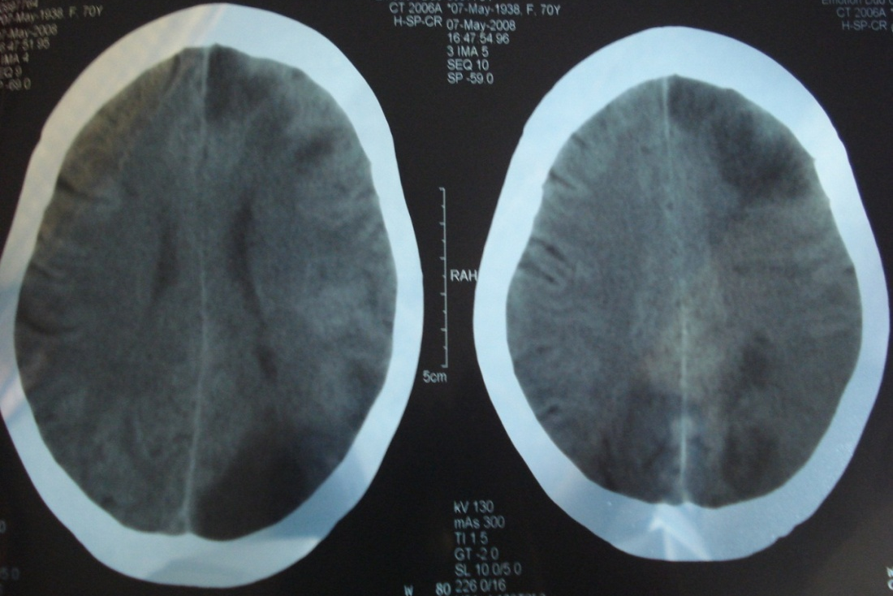
Multiple bilateral infarcts
This is a non contrast multi slice axial plan CT scan of head showing multiple hypo dense shadow in left frontal, parietal, occipital lobe & rt. Occipital lobe also.
So, my radiological diagnosis is multiple bilateral infarct in various artery territories.
Q: 1. What is the probable cause of this infarct ?
2. What will be the clinical features ?
3. Further investigations?
4. Treatment plan.

Slide 34
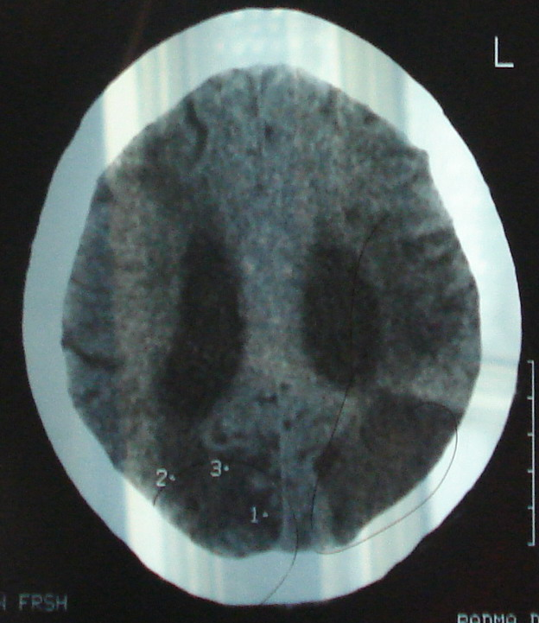
Bilateral infarct of variable ages
Figure: This is a non contrast axial plan CT scan of head showing a hypo dense shadow in right parietal lobe.
So, my radiological diagnosis is infarct in right Bilateral posterior cerebral artery territory
Q: 1. What is the probable cause of this infarct ?
2. What will be the clinical features ?
3. Further investigations?
4. Treatment plan.

Slide 35
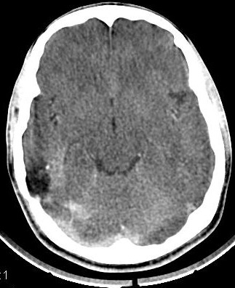
Cortical infarct in MCA Territory
Figure: This is a non-contrast axial plan CT scan of head showing a small hypodense area in the right parietal lobe involving the cortex only.
So, my radiological diagnosis is Cortical infarct in right MCA (M3) territory.

Slide 36
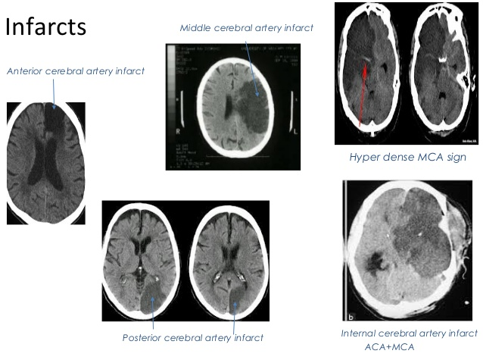
Fig: Sites of infraction in relation to cerebral arteries

Slide 37
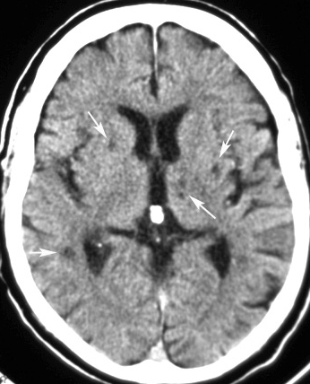
Lacunars infarct
This is a non-contrast CT scan of head showing multiple small hypodense shadows in bilateral thalamoganglionic regions.
So, my radiological diagnosis is bilateral lacunar infarcts.
Q: What will be the possible cause.
Notes:
Ans: Athero-embolism.

Slide 38
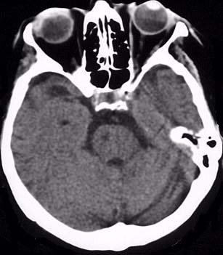
Infarct in the pons
This is a non contrast axial plan CT scan of head showing a hypo dense shadow in right side of the pons.
So, my radiological diagnosis is infarct in the pons.

Slide 39
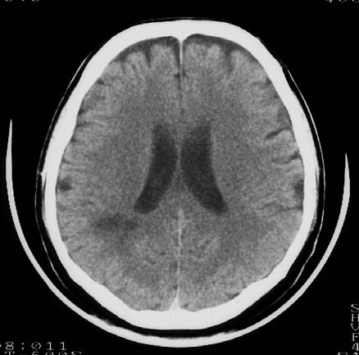
Infarct in a patient of hypovolumic shock

Slide 40
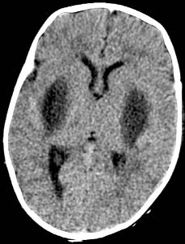
Bilateral infarct in hypoxic ischaemic encephalopathy
This is a non-contrast axial plan CT scan of the head showing bilateral hypodense shadows in putamenial region.
So, my radiological diagnosis is Bilateral basal ganglia infarct . D/D:
1. Hypoxic ischaemic encephalopathy.
2. Toxic encephalopathy.

Slide 41
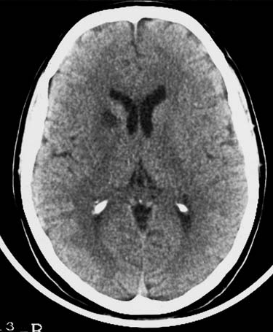
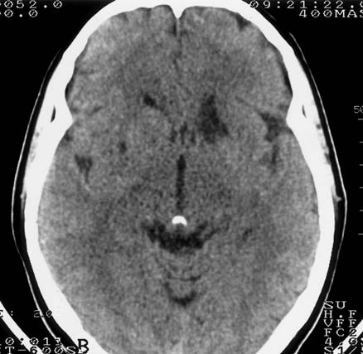
Basal ganglia Infarct

Slide 42
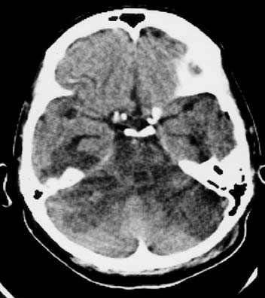
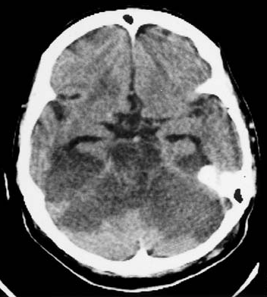
Bil. Cerebellum & brain stem infarct

Slide 43
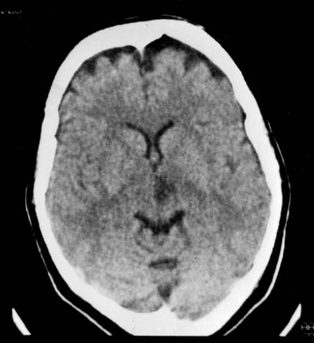
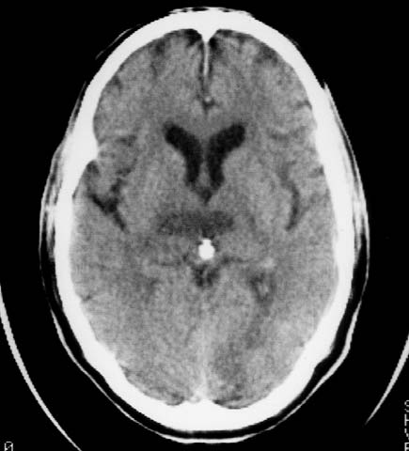
Thalamic infarct

Slide 44
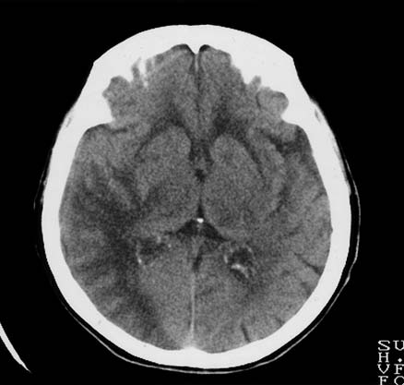
Infarct in right MCA territory with gyral-enhancement

Slide 45
Table: Age determination of infarction CT
New Infarct | Old Infarct
Light black | Dark black
Sulci is not seen | Sulci is seen
Lighter | Dense
Ventricle Compressed | Ventricle enlarged

Slide 46

Recent / New infarct
Old infarct
Hypodense.
Larger.
Ventricles- pressure effect.
Sulcus obliterated in same side.
More hypodense
Smaller – due to gliosis in surrounding area.
Ventricles- no pressure effect.
Sulcus prominent.

Slide 47
This is a non-contrast axial plan CT scan of the head showing bilateral hypodense shadows in putamenial region
So, my radiological diagnosis is Bilateral basal ganglia infarct due to,
1. Hypoxic ischaemic encephalopathy.
2. Toxic encephalopathy.

Slide 48
B. Old hemorrhage

Slide 49
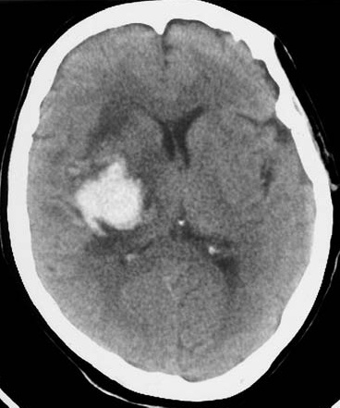
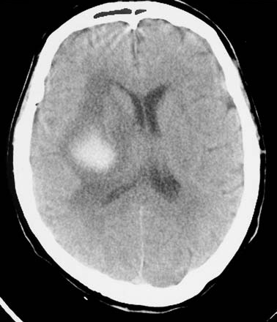
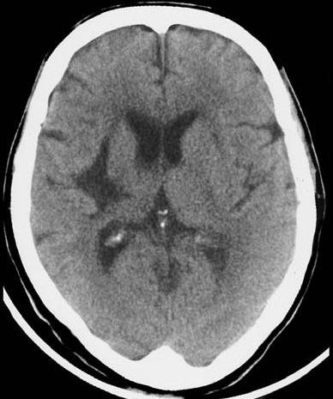
Old hemorrhage : Resolving haematoma
2 days
2 weeks
2 months

Slide 50
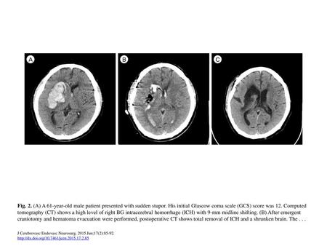
Old hemorrhage

Slide 51
C. Cystic lesion in brain

Slide 52
Porencephaly
Porencephaly is the presence of cysts or cavities within the brain that result from developmental defects or acquired lesions, including infarction of tissue.
True porencephalic cysts are most commonly located in the region of the sylvian fissure and typically communicate with the subarachnoid space or the ventricular system, or both.

Slide 53
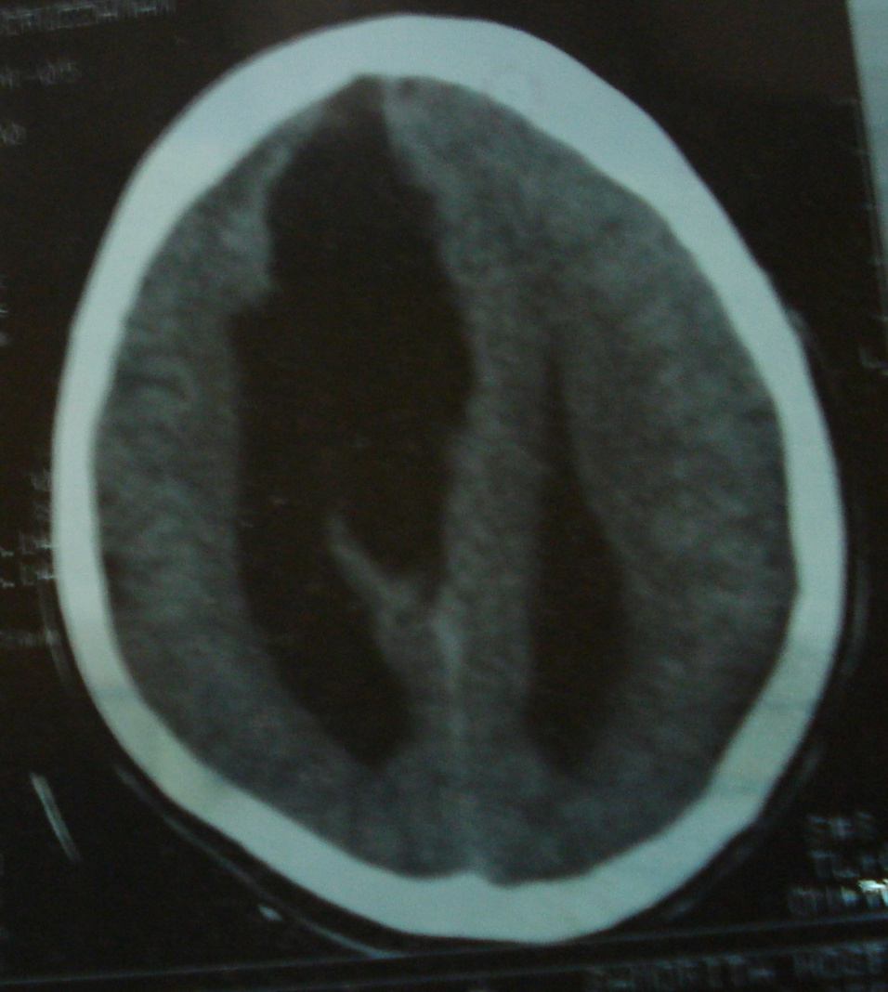
Porencephalic cyst/cavity after stroke
Figure: A Large size cyst in the right fronto-parietal region has a communication with the anterior horn of the right lateral ventricle.
So, my radiological diagnosis is porencephalic cyst.

Slide 54
Arachnoid cyst
An arachnoid cyst is a small, benign sac that develops between the brain or spinal cord and the arachnoid membrane.
It most often occurs in the brain, where it is also called an intracranial cyst, but an arachnoid cyst can develop in the spinal cord as well.

Slide 55
Arachnoid cyst
Figure : CT images showing a large hypodense cavity in the frontal, temporal, and parietal lobes with midline shift and pressure on.

Slide 56
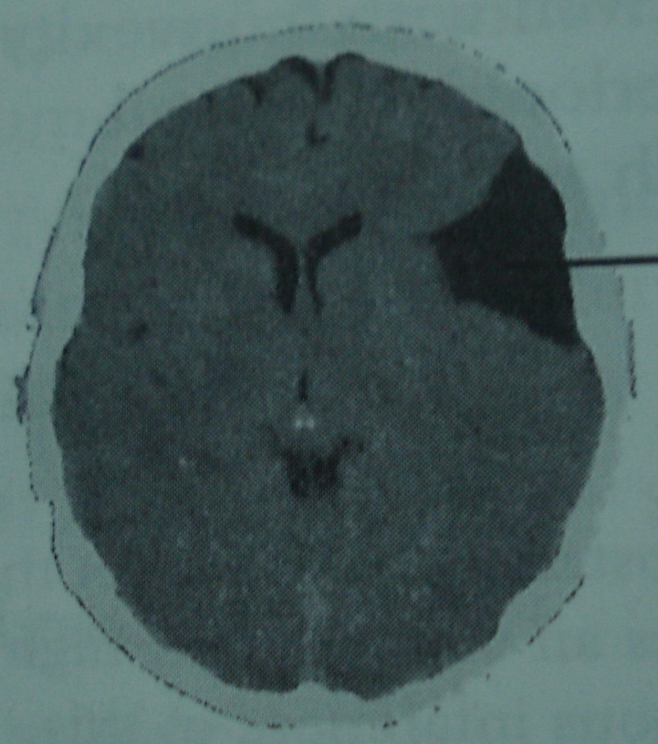
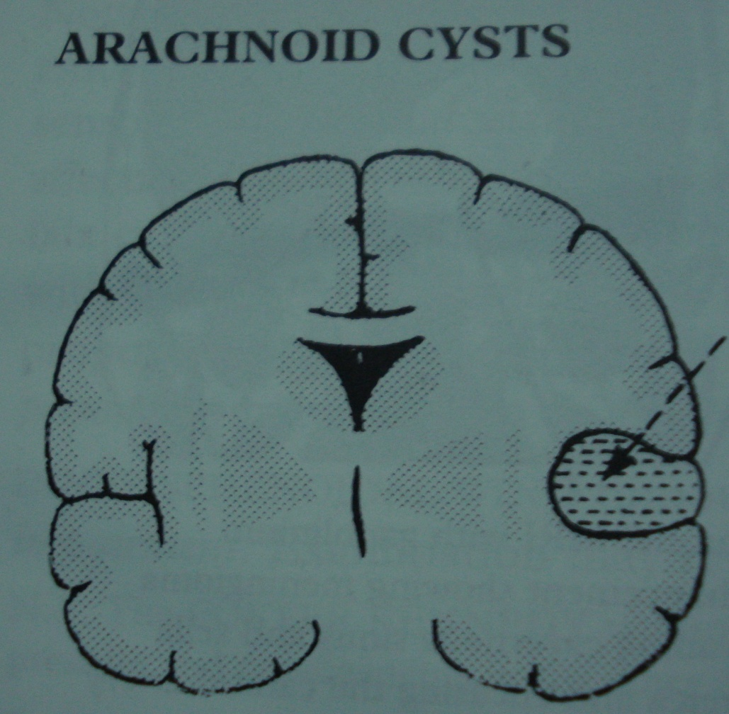
Arachnoid cysts

Slide 57
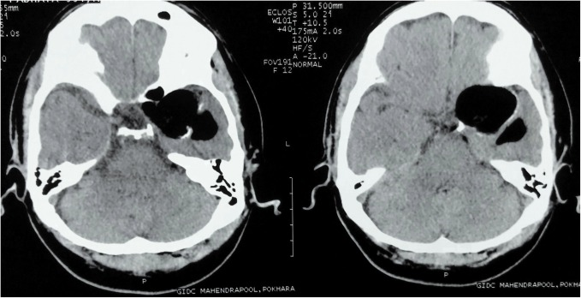
Epidermoid cyst
Fig. 1. Axial CT image showing large intracranial fat density lesion with patchy peripheral calcification in left temporal fossa causing mass effect on surrounding structures.

Slide 58
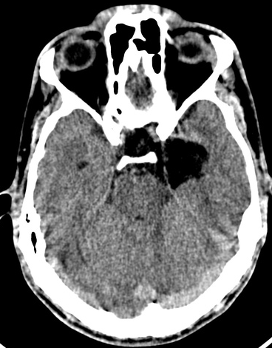
Dermoid cyst
A non-contrast computed tomography (CT scan) revealed a heterogeneous low attenuation lesion centered in the left para sellar cistern (extra-axial fat-containing mass).

Slide 59

Ruptured dermoid cyst
Calcified walled left sellar and perasellar lesion with internal fat density material with additional fat locules in sylvian fissures bilaterally, sulci and right ambient cistern consistent with fat of ruptured dermoid cyst.
Additionally noted lacunar infarcts right basal ganglia.

Slide 60
D. Cerebral edema

Slide 61

Cerebral edema

Slide 62

Cytotoxic edema
Figure: CT scan of head showing hypodense lesion involves both cortical grey and white matter and loss of normal grey white interphage of left cerebral hemisphere with midline shift.
So, my radiological diagnosis is infract with cytotoxic edema of left cerebral hemisphere.

Slide 63
Vasogenic edema
Figure: CT scan of head showing hypodense with finger like projection confined to white matter, with finger like projections extending in sub cortical white matter which spares cortical grey matter which does not maintain vascular territory.
Grey white matter interphase is pronounced of right fronto-parietal region of right cerebral hemisphere and left parieto-occipital region with midline shift.
So, my radiological diagnosis is vasogenic edema of both cerebral hemispheres.

Slide 64

Vasogenic edema
Figure: Oedema not due to infarct because it does not maintain vascular territory.
So, my radiological diagnosis is vasogenic edema of both cerebral hemispheres.

Slide 65
Differentiation of Cytotoxic vs Vasogenic edema
Cytotoxic edema | Vasogenic edema
Present in ischemia infarct | Present in around bleed, infective or inflammatory lesion like granuloma abscess, tumour, and acute hypertensive encephalopathy.
2. It is seen as an abnormal area of uniform low attenuation or abnormal signal intensity, | 2. It is seen as an abnormal area of low attenuation or abnormal signal intensity confined to white matter around the lesion, with finger like projections extending in sub cortical white matter.
3. The area of involvement corresponds to particular vascular territory, | 3. It spares overlying adjacent cortical grey matter.
4. It involves cortical grey as well white matter | 4. Involves only the white matter
5. It losses of normal grey white matter interphase | 5. Grey white matter interphase is pronounced instead of loss.

Slide 66

Interstitial edema
Figure: CT (a&b)showed diffuse ventriculomegaly with fluid level, suggesting hydrocephalus .CT showed multifocal low attenuation in periventricular white matter due to transependymal flow of CSF suggesting interstitial edema (white arrows).

Slide 67

Osmotic edema
Figure : CT head showing the ventricles are slit like (red arrow) and the cortical sulci are diffusely absent (blue arrow), consistent with diffuse cerebral edema suggesting osmotic edema.

Slide 68
E. Hydrocephalus

Slide 69

Figure: Baby with hydrocephalus
Hydrocephalus

Slide 70

Communicating hydrocephalus

Slide 71


Communicating hydrocephalus

Slide 72


Obstructive hydrocephalus due to cerebral aqueduct obstruction

Slide 73

Cerebral aqueduct obstruction

Slide 74

Obstructive hydrocephalus
Figure: This is a non contrast axial plan CT scan of head showing gross ventriculomegaly of both lateral ventricles with non visualization/ obscuration of the third ventricle.
So, my radiological diagnosis is Obstructive / non communicating hydrocephalus due to cerebral aqueduct obstruction.

Slide 75

Obstructive hydrocephalus
Figure: This is a non contrast axial plan CT scan of head showing gross ventriculomegaly of both lateral ventricles with non visualization/ obscuration of the third ventricle.
So, my radiological diagnosis is Obstructive/ non communicating hydrocephalus due to cerebral aqueduct obstruction.

Slide 76

Figure: This is a multi slice axial plan CT scan of the head showing a large hyperdense mass lesion in the sellar region with dilated lateral ventricle.
The postcontrast images showing there is homogeneous enhancement the lesion.
So my radiological diagnosis is pituitary macroadenoma with obstructive hydrocephalus.
Obstructive hydrocephalus

Slide 77
F. ICSOL

Slide 78
Primary brain tumours

Slide 79

Astrocytoma
Figure : CT shows a solid-cystic heterogeneous lesion on the left thalamo-lenticular region, with intense postcontrast enhancement of the solid portion (arrow). The lesion is well circumscribed, with no associated vasogenic edema. It collapses the third ventricle, causing dilatation of the lateral ventricles. So my radiological diagnosis is Thalamo-lenticular pilocytic astrocytoma

Slide 80


Figure: CT Identified is a mass lesion of the right cerebellar hemisphere characterised by a cystic core and thick rim of solid tissue which compresses the 4th ventricle and brainstem resulting in obstruction of the aqueduct of Sylvius and obstructive hydrocephalus.
Pilocytic astrocytoma

Slide 81


Pituitary adenoma
CT demonstrates a large mass in the region of the pituitary fossa. A slightly hyperdense component extends superiorly indenting the floor of the third ventricle. The mass demonstrates moderate enhancement/

Slide 82


Pituitary macroadenoma
Axial CT cntrast shows a large mass is seen within sellar fossa and suprasellar cistern that causes ballooned sella and compresses the optic chiasm and floor of 3rd ventricle superiorly. Sellar floor and upper clivus and sphenoidal sinus are invaded by the mass.

Slide 83


Craniopharyngioma
Figure: Axial CT scans shows note the large lesion with calcification which is located in the suprasellar region Contrast enhanced CT demonstrates a suprasellar mass which vividly enhances.

Slide 84

Figure: This is a multi slice axial plan CT scan of the head showing a mixed density mass lesion in the right fronto-parietal of the brain with midline shift(A).
The postcontrast images showing there is homogeneous enhancement the lesion(B&C).
So my radiological diagnosis is large meningioma.
Meningioma

Slide 85


Meningioma
Plain CT
Contrast CT
This is a multi slice axial plan CT scan of the head showing a isodense shadow in fronto-parietal region, just underneath the skull. After giving contrast it take contrast uniformly. So, my radiological diagnosis is Meningioma.

Slide 86


Meningioma

Slide 87


Medulloblastoma
Figure: This is a multi slice axial plan CT scan of the head showing hyperdense ring shadow in the cerebellum with compression of the 4th ventricle and post contrast enhancing diffusely and homogeneously.
So my radiological diagnosis is medulloblastoma.

Slide 88

Germinoma
Figure: This is a non contrast axial CT scan of the head showing a hyper dense with calcification in the pineal region. There is homogeneous enhancement, which is common for a tumor in the pineal region.
So, my radiological diagnosis is most likely a germinoma.

Slide 89


Germinoma with obstructive hydrocephalus
Figure: CT demonstrates A large lobulated mixed density mass is centered on the pineal gland, engulfing the pineal calcification which is enhanced after contrast . It is somewhat hyperdense compared to adjacent brain. The midbrain is distorted, compressed and demonstrates low density suggestive of edema. Obstructive hydrocephalus is present.

Slide 90

Figure: CT Hyperdense and Homogenous Enhancement in CNS Lymphoma .
CNS Lymphoma

Slide 91


Acoustic schwanoma

Slide 92
Cerebral ring enhancing lesion
MAGIC DR mnemonic
M - Metastasis
A - Abscess
G - Glioblastoma multiforme
I - Infarct (subacute phase)
C - Contusion
D - Demyelinating disease (e.g. tumefactive MS)
R - Radiation necrosis

Slide 93
Single ring enhanced lesions
Cerebral abscess
Primary brain tumour ( usually glioma)
Single metastasis
Single tuberculoma
** Ring enhancement is due to breakage of BBB due to compression by rapidly growing SOL

Slide 94

Figure: A = metastasis, B = abscess, C = radiation necrosis,
D = GBM, E = demyelination, F = contusion.

Slide 96

Enhancing wall characteristics
  Thick and nodular favours neoplasm
  Thin and regular favours abscess
  Incomplete ring often opened toward the cortex favours demyelination

Slide 97
Ring enhanced lesions
Complete ring
Cerebral abscess
Primary brain tumour
Metastasis
Tuberculoma
Incomplete / Open ring
Demyelinating disease

Slide 98

Ring enhanced lesions

Slide 99


Figure: Glioblastoma multiforme. The CT and MRI studies show a large, necrotic left hemispheric glioblastoma associated with extensive perilesional vasogenic oedema resulting mass effect
Glioblastoma multiforme

Slide 100


Malignant astrocytoma

Slide 101


Brain abscess

Slide 102
1.Tuberculoma
2. Secondaries
3. Multiple abscess
Same D/D but sequence is changed:
** Tuberculoma and metastasis is usually multiple whereas cerebral abscess is usually single.
Multiple ring enhanced lesions

Slide 103
Multiple cerebral metastases
Five primary tumors account for 80% of brain metastases:
Lung cancer
Renal cell carcinoma
Breast cancer
Melanoma
Gastrointestinal tract adenocarcinomas
(the majority colorectal carcinoma)

Slide 104



Secondaries/ metastases in the brain
Plain CT
Contrast CT

Slide 105


Secondary metastasis in the brain
Plain CT
Contrast CT
This is a multi slice axial plan CT scan of the head showing hyperdense ring shadow in right parietal and left frontal lobe. There are also perilesional hypodense shadows with finger like projection. In post contrast CT there are significant ring enhancement.
So my radiological diagnosis is secondary metastasis in brain with perilesional oedema.

Slide 106

Multiple brain abscess
Figure: This is a multi slice axial plan post contrast CT scan of the head showing hypodense ring enhancement shadow in right parietal, occipital and left frontal and parietal lobe. There are also perilesional hypodense shadows around ring enhancement lesions.
So my radiological diagnosis is with multiple brain abscesses with perilesional oedema.
D/D:
1.Tuberculoma
Brain abscess
3. Secondaries
Contrast CT

Slide 107

Tuberculoma
Figure : Axial images of contrast-enhanced computed tomography of the brain show numerous small enhancing masses with marked surrounding edema in both cerebral and cerebellar hemispheres and the brain stem.

Slide 108
Difference between Infarct and ICSOL
Infarct | SOL
1. Maintain vascular territory. | 1. Not maintain
2. Not well circumscribed | 2. Well circumscribe margin
3. Oedema – small / not disproportionate | 3. Oedema – disproportionate/ large
4. No / minimal pressure effect | 4. Pressure effect (sulcal & ventricular effacement, midline shifting)
5. Not take contrast at margin (enhancement) | 5. Contrast enhancement (at margin / tissue)

Slide 109
G. CNS infections

Slide 110

Meningitis
Figure: A, Axial noncontrast scan shows obliteration of the sulci over the hemispheres. No enlargement of the ventricles was observed. B, Subtle meningeal enhancement was noted on contrast-enhanced CT scan.

Slide 111

Meningoencephalitis with Hydrocephalus
A, There is intense enhancement of the basal cisterns. Enlargement of the fourth ventricle and temporal horns is compatible with communicating hydrocephalus. B, Axial CT of the same patient at the level of the sylvian fissures.

Slide 112

Meningoencephalitis with Hydrocephalus

Slide 113

Figure: This is a non contrast multislice axial plan CT scan of Head showing generalized disappearances of all sulci and slit like lateral ventricles.
So my radiological diagnosis is Cerebral oedema probably in Encephalitis
Encephalitis

Slide 114

Encephalitis
Figure: This is a non contrast multislice axial plan CT scan of Head showing hypodensity in the right temporal lobe and bilateral inferior occipital / posterior temporal lobes.
So my radiological diagnosis is Encephalitis probably in HSV encephalitis

Slide 115

Meningoencephalitis
Figure: This is a contrast axial CT scan of the head showing meningeal enhancement with fullness of sulci.
So, my radiological diagnosis is Post contrast meningeal enhancement in Tuberculous - Meningoencephalitis.

Slide 116
H. Air/ Paranasal sinus

Slide 117

Paranasal sinus in CT

Slide 118

Pneumocephalus
Figure : Axial CT revealing a large area of pneumocephalus in the bilateral anterior cranial fossa. The frontal retention of air caused widening of the interhemispheric fissure.
Cause: endoscopic resection of a giant meningioma in the anterior skull base

Slide 119

Pneumocephalus
Figure : Axial CT revealing a multiple areas of pneumocephalus in the bilateral anterior cranial fossa. The frontal retention of air caused widening of the interhemispheric fissure due to head trauma

Slide 120

Acute Maxillary sinusitis
Figure: CT shows a fluid level in the left maxillary sinus.

Slide 121

Chronic Maxillary sinusitis
Figure: CT shows a fluid level in the both maxillary sinus (left>right).

Slide 122

Ethmoidal & Sphenoid sinusitis
Figure: Opacified Ethmoidal and sphenoid sinuses (right)o

Slide 123

Frontal sinusitis

Slide 124

Sphenoid sinusitis
Figure: Opacified sphenoid sinuses (right more so than the left), with obstruction of sphenoethmoid recess.

Slide 125
Thank you

