Slide 1
Intracranial Space Occupying Lesions in MRI-2
Prof. Dr. Aminur Rahman
FCPS (Med), MD(Neuro) ,FINR (Switzerland), FACP (USA),FICP(India)
Trained Interventional Neuroradiology (Thailand) , MAAN(USA)
Professor and Head
Department of Neurology
Sir Salimullah Medical College

Slide 2
Introduction
Infectious diseases affecting the central nervous system (CNS) range from acute to chronic, from indolent to life-threatening, and from self-limited to relentlessly progressive.

Slide 3
Introduction
MRI is an important tool in the diagnosis of CNS infections.
It allows for identifying various infectious patterns, differentiates them from vascular pathologies or neoplasms, may raise suspicion about a specific pathogen agent and plays an important role in monitoring response to treatment.

Slide 4
MR protocol for infections
The mainstays of MR protocol are the
    T2WI
    FLAIR and
    T1W with gadolinium (Gd).
The basic differentiation is extra-axial (i.e., outside the brain) versus intra-axial (i.e., inside the brain).
The latter may further be differentiated into, for example, ring-enhancing lesion, temporal lobe lesion, basal ganglia lesion and white matter abnormality.
Leptomeningeal involvement is typically not depicted on T₂ sequences, but it might be seen on FLAIR images or on T₁ Gd-enhanced images

Slide 5
Gradient echo (GRE)
Gradient echo (GRE) T₂ sequence is sensitive to the inhomogeneity of the magnetic field induced by paramagnetic substances, such as the decomposition products of hemoglobin or calcium.
It is therefore of particular importance in the evaluation of possible herpetic encephalitis, abscess or neurocysticercosis.
T₂ and GRE T₂ hypointensity of the wall suggest infection (due to free radicals induced by macrophage activation), but it is possible in tumors also (related to the hemorrhage, with ‘blooming effect’ on GRE T₂).

Slide 6
Susceptibility weighted imaging (SWI)
SWI is a relatively new MR imaging sequence based on susceptibility differences between tissues, has been shown to be far superior to conventional T₂ or GRE T₂ sequences detecting microhemorrhages , and could thus be of potential value in cases of hemorrhagic infectious.

Slide 7
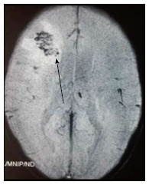
Figure: Foci of blooming (arrow) noted within the abscess is suggestive of haemorrhage and points to a fungal cause.

Slide 8
Diffusion weighted imaging
DWI is sensitive to the brownian movement of water molecules that might be altered in various infectious processes.
Restricted diffusion is due to the highly viscous proteinaceous fluid of pyogenic abscess , to the cytotoxic edema usually associated with irreversible neuronal damage of herpes virus encephalitis, or to the cytotoxic edema of the infected oligodendrocytes in progressive multifocal leukoencephalopathy (PML) .

Slide 9
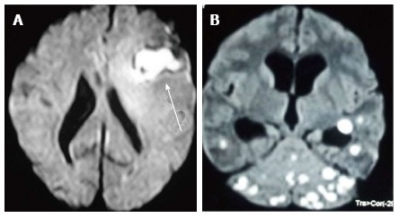
Figure: Diffusion weighted images show central restriction of diffusion in bacterial abscess (A) and tuberculomas (B) arrow.

Slide 10
MR spectroscopy
Proton MRS enables noninvasive in vivo quantification of normal and abnormal metabolite concentration in the brain.
It has been proved to offer valuable complementary data to the classical MR protocol , assisting in the differential diagnosis of intracranial cystic lesions , granulomas and encephalitis.
Main metabolites identified are N-acetylaspartate (NAA; marker of neuronal viability), choline (marker of cellular membrane turnover), creatine (cerebral metabolism marker), myo-inositol (astrocyte marker), lactate (not present in the adult normal brain, indicates anaerobic glycolysis) and free lipids (necrosis).

Slide 11
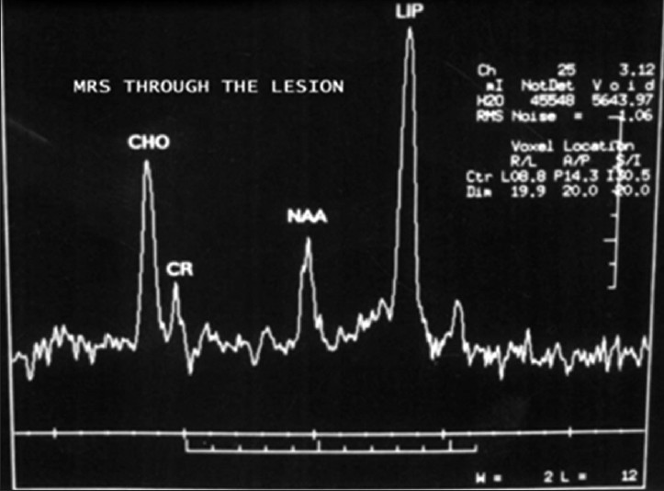
MRS of Tuberculoma
Figure : The magnetic resonance spectroscopy brain in the case of tuberculoma showing grossly diminished N-acetylaspartate peak and a distinct lipid peak

Slide 12
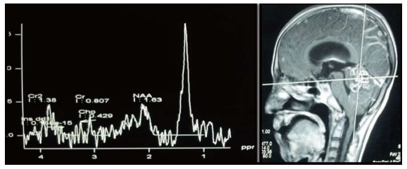
MRS of Tuberculoma
Figure : The magnetic resonance spectroscopy brain in the case of tuberculoma showing grossly diminished N-acetylaspartate peak and a distinct lipid peak.

Slide 13
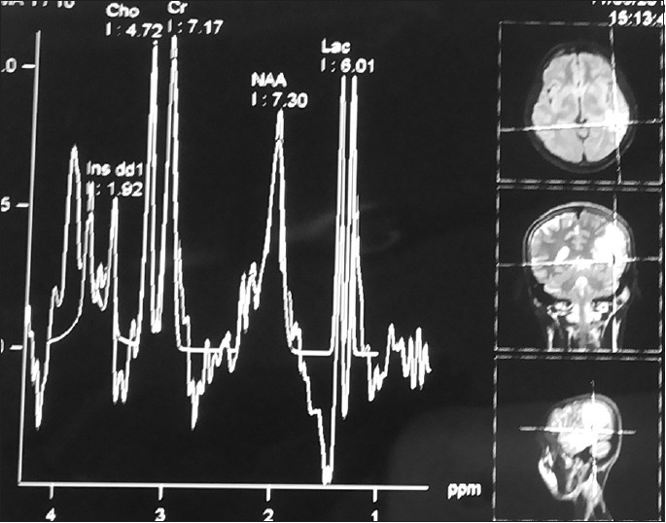
Figure: The magnetic resonance spectroscopy brain in neurocysticercosis showing moderately diminished N-acetylaspartate and presence of a lactate peak but absence of a lipid peak.
MRS of Neurocysticercosis

Slide 14
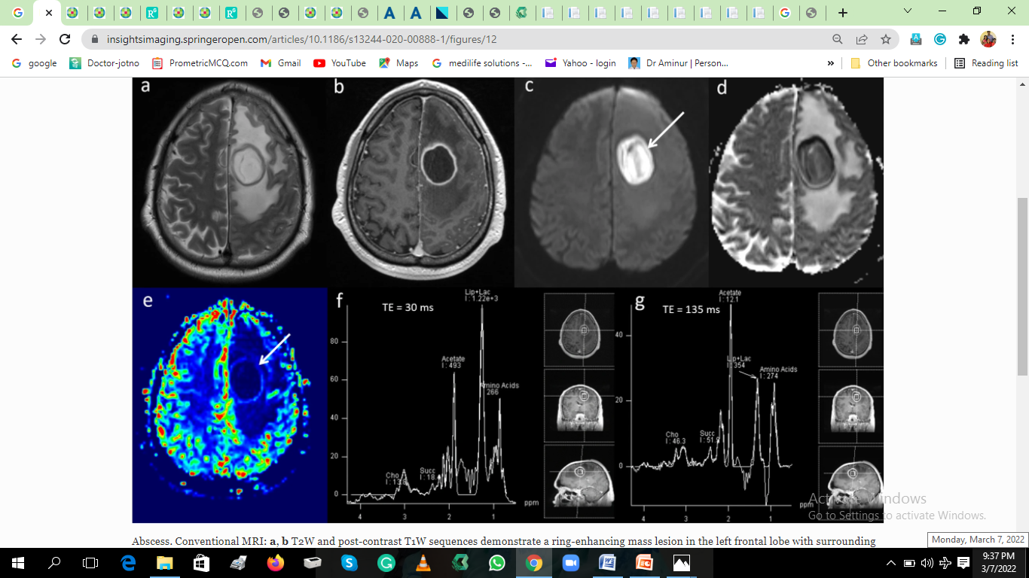
MRS of Cerebral abscess
Fig: MRS shows high lipid as well as the presence of amino acid (0.9–1.0 ppm), acetate (1.92 ppm) and succinate peaks (2.42 ppm).

Slide 15
Extra-axial lesions
Extra-axial lesions include epidural empyema, subdural empyema and leptomeningitis;
it is important to identify possible sources for infection (e.g., sinusitis, mastoiditis and otitis media) and complications (e.g., brain abscess, dural sinus thrombosis, infarction and hydrocephalus)

Slide 16
Intra-axial temporal lobe lesion
Intra-axial temporal lobe lesions include encephalitis (most notably herpes simplex encephalitis and Japanese encephalitis [JE]), infarction, infiltrating gliomas and limbic encephalitis .
In viral encephalitis, the clinical context (fever, headaches and seizures) and the imaging features (restricted diffusion and hypoperfusion) help the differential diagnosis.

Slide 17
Intra-axial deep gray matter nuclei lesion
Intra-axial deep gray matter nuclei lesions include multiple vascular, neoplasm, metabolic causes, but also infectious (such as Cryptococcus pseudocysts, Creutzfeldt–Jakob disease).
Bilaterally symmetric diffuse abnormalities involving entirely the basal ganglia suggest systemic or metabolic causes, while asymmetric or focal lesions involving partially the basal ganglia tend to indicate an infectious origin or neoplasms.

Slide 18
Classification of lesions on CNS infections in MRI

Slide 19
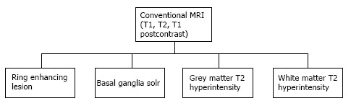
Classification of lesions on conventional MRI in suspected CNS infections.

Slide 20
Grey matter hyperintensity
T2/ FLAIR hyperintensity involving the grey matter may be seen in encephalitis as well as infarction. This differentiation is aided by diffusion and perfusion sequences (Table).

Slide 21
Table :This differentiation is aided by diffusion and perfusion sequences
 | Diffusion | Perfusion
Infection | Restricted | Increased
Infarction | Restricted | Decreased

Slide 22
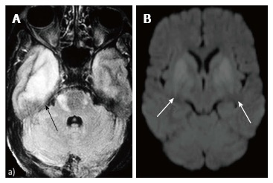
Fluid Attenuated Inversion Recovery Sequence in a patient with fever and altered sensorium shows hyperintensity predominantly in the grey matter of both temporal lobes and also in cerebellum. This patient was diagnosed with Japanese B Encephalitis. A similar picture may be seen in other viral encephalitis including herpes encephalitis.

Slide 23
Intra-axial ring-enhancing lesion
The infectious lesions tend to have a thin and regular rim of contrast enhancement, while necrotic tumors have a thicker and irregular wall.
A well-known sign for infectious lesions is the DWI hyperintensity of the content that favors the hypothesis of the pyogenic, tuberculous or even fungal abscess; this sign is not pathognomonic because it may also be encountered in hemorrhagic brain tumors.
Note that some common infectious lesions do not regularly present with hyperintense central DWI, such as toxoplasmic abscesses or cysticercoid cysts.

Slide 24
Ring-enhancing lesion
All mature abscesses whether bacterial, fungal or pyogenic are hypointense on T1, hyperintense on T2 and show ring enhancement following intravenous Gadolinium injection.

Slide 25
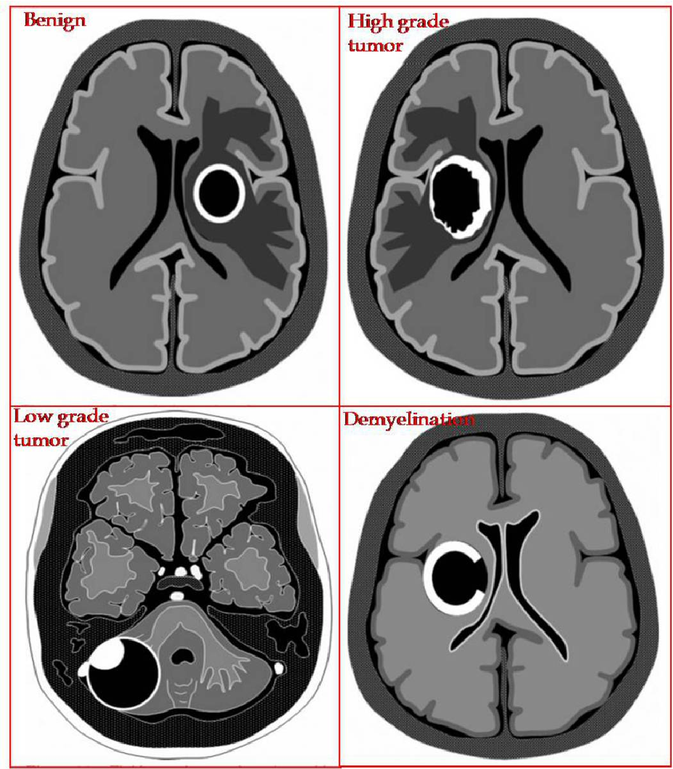
Enhancing wall characteristics
  Thick and nodular favors neoplasm
  Thin and regular favors abscess
  Incomplete ring often opened toward the cortex favors demyelination
  Intermediate to low T2 signal capsule favors abscess
  Restricted diffusion of enhancing wall favors GBM or demyelination

Slide 26
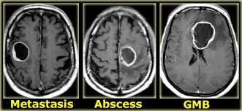
Closed ring lesions

Slide 27
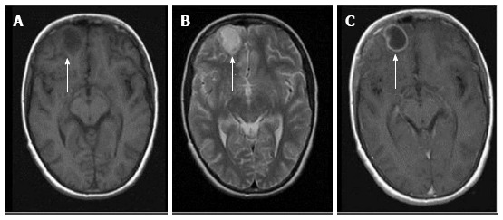
Figure: Ring enhancing lesions. T1 (A), T2 (B) and T1 (C) post gadolinium images from the magnetic resonance of an acutely ill child with fever. A ring enhancing lesion is seen in the right frontal lobe. So my radiological diagnosis is brain abscess.

Slide 28
White matter hyperintensities (focal or diffuse )
Focal or diffuse white matter lesion may be caused by various CNS infections, such as Lyme disease, HIV encephalopathy and PML.
The major diagnostic considerations are HIV encephalopathy (HIVE) and progressive multifocal leukoencephalopathy (PML) .
Though both entities have characteristic imaging features on conventional MR sequences (Table ​) they may be difficult to differentiate due to overlapping feature

Slide 29
Role of White matter hyperintensities
 | T1 | T2 | T1 + contrast
HIV Encephalopathy | Isointense | Bilaterally symmetrical periventricular white matter hyperintensities | No enhancement
PML | Hypointense | Asymmetrical lesions involving subcortical and periventricular white matter | Faint peripheral areas of enhancement may sometimes be seen
HIV: Human immunodeficiency virus
PML: Progressive multifocal leukoencephalopathy.

Slide 30
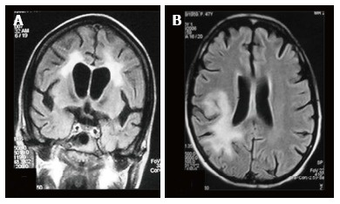
FLAIR Sequence image of a patient with
(A) human immunodeficiency virus encephalopathy showing symmetrical periventricular white matter hyperintensity and
(B) progressive multifocal leukoencephalopathy showing asymmetrical involvement of white matter, predominantly posterior subcortical white matter, with extension into the periventricular region

Slide 31
Basal ganglia space occupying lesions
A number of CNS lesions are seen characteristically involving the region of basal ganglia.
The differential diagnosis in this category includes cryptococcosis, toxoplasmosis and primary CNS lymphoma.
Cryptococcosis usually does not show enhancement after gadolinium injection.

Slide 32
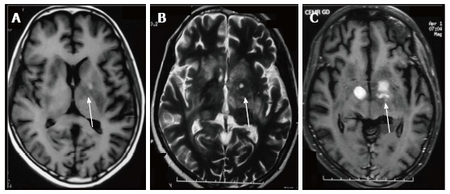
Figure: CNS lymphoma.
T1 (A), T2 (B) and Post gadolinium T1 (C) weighted images in an human immunodeficiency virus-positive patient with space occupying lesions in bilateral basal ganglia.
Differentials include
Toxoplasmosis,
Cryptococcosis and
Central nervous system (CNS) lymphoma.

Slide 33
Infectious diseases of the brain

Slide 34
Bacterial infections
Bacterial infections may affect the CNS and any of the layers of meninges producing abscesses, ventriculitis, meningitis, subdural and epidural empyemas.
Commonly, the imaging findings are nonspecific regarding the bacteria involved.

Slide 35
Pyogenic abscess
MRI shows pyogenic abscess as a round/oval-shaped mass with a central area of suppurative necrosis and a peripheral capsule.
The central necrotic area is hypointense to the cerebral white matter on T1-weighted (w) and hyperintense on T2-w images.
The external capsule appears typically as a complete hypointense on T2-w and hyperintense on T1-w images rim.
However, the T2 hypointensity of the capsule and the regular contrast enhancement can be present in non-pyogenic abscesses (Mycobacterium tubercolaris, Toxoplasma, Aspergillus), in some cases of necrotic tumors and in lymphomas

Slide 36
Pyogenic abscess
After intravenous injection of contrast mediun (gadolinium), abscess shows a typical peripheral thin and regular ‘‘ring enhancement’’ that corresponds to the T2 hypointense rim .
It is important to note that the peripheral contrast enhancement can be stronger in the portion of the abscess closest to the grey matter, because of the stronger inflammatory reaction due to the bigger vascularization of the grey matter.

Slide 37
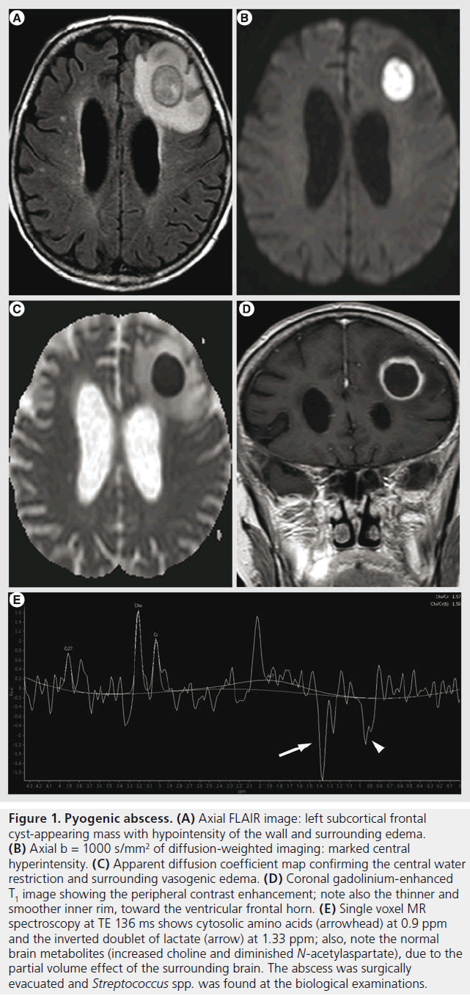
Figure . Pyogenic abscess.
Axial FLAIR image: left subcortical frontal cyst-appearing mass with hypointensity of the wall and surrounding edema.
(B) Axial diffusion-weighted imaging: marked central hyperintensity.
ADC map confirming the central water restriction and surrounding vasogenic edema.
Coronal Gd-enhanced T1 image showing the peripheral contrast enhancement; note also the thinner and smoother inner rim, toward the ventricular frontal horn.

Slide 38
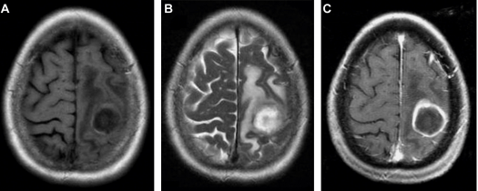
Figure: Supratentorial pyogenic abscess in the left parietal lobe.
T1-weighted (A), T2-weighted (B), gadolinium enhanced T1-weighted (Gd-MR) (C), MR images. The capsule of the abscess is hyperintense in T1-weighted image (A), partially hypointense in T2-weighted image (B) with surrounding vasogenic oedema. Gd-MR image shows a ring-enhancing mass.

Slide 39
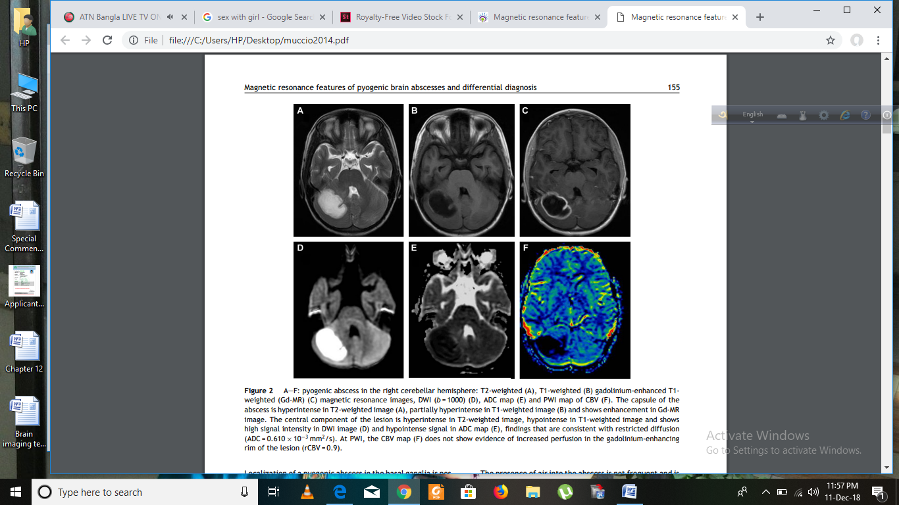
Figure: Pyogenic abscess in the right cerebellar hemisphere
T2-weighted (A), T1-weighted (B) gadolinium-enhanced T1- weighted (Gd-MR) (C) magnetic resonance images,
The capsule of the abscess is hyperintense in T2-weighted image (A), partially hyperintense in T1-weighted image (B) and shows enhancement in Gd-MR image. The central component of the lesion is hyperintense in T2-weighted image and hypointense in T1-weighted image.

Slide 40
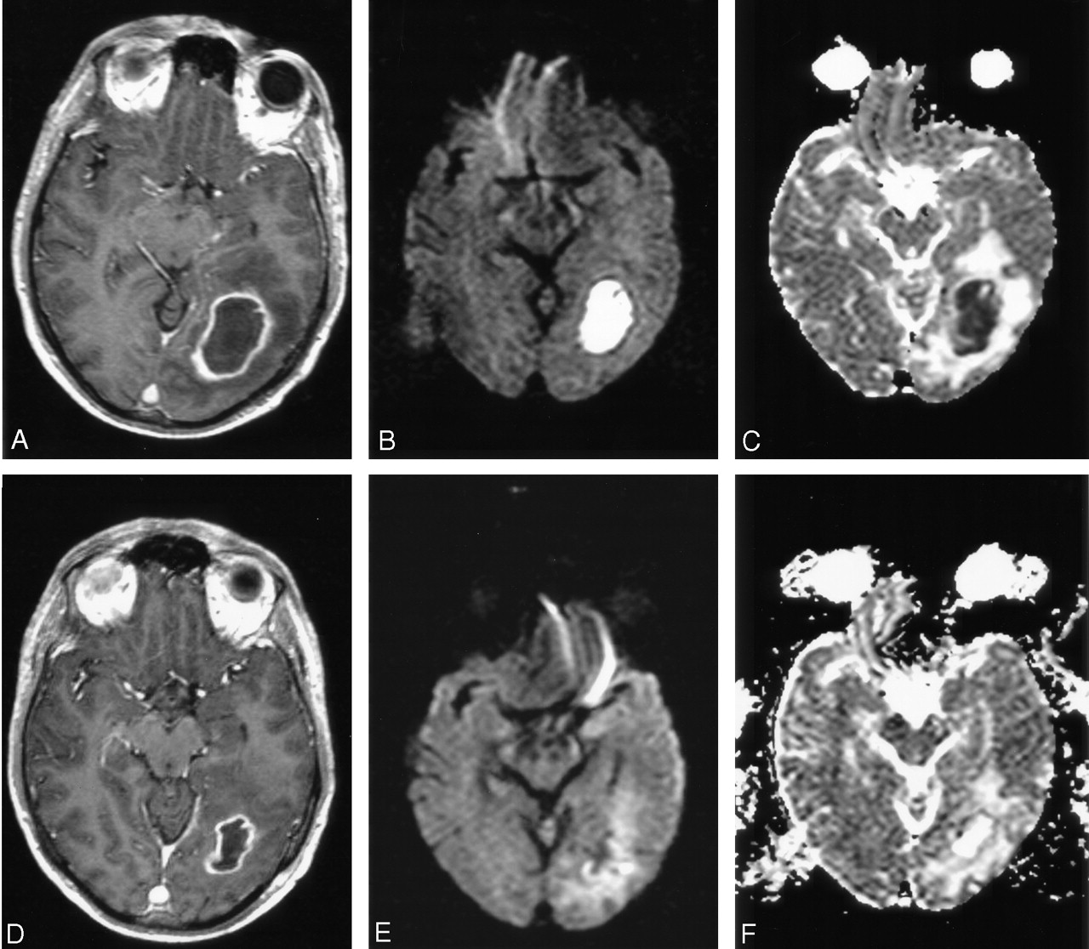
Figure: Pyogenic abscess in the left parietal region
DW images were well correlated with conventional MR images, showing no re-accumulation of pus.
A, Axial contrast-enhanced T1-weighted image shows a ring-enhancing lesion in the left occipital region, with perifocal edema.
B and C, Trace DW images show a hyperintense lesion and a low ADC indicating restricted diffusion.
Note:
D–F, Four days after surgical drainage, contrast-enhanced T1-weighted image (D) shows that the lesion is diminished, with predominantly low signal intensity on a DW image (E) and a high ADC on ADC map (F); these finding suggest clear fluid in the abscess cavity.

Slide 41
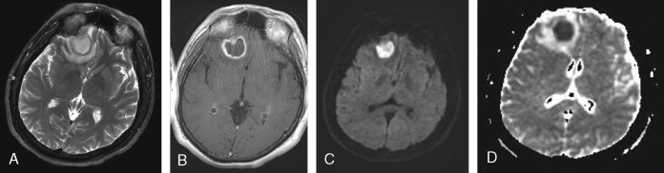
Figure: Cerebral abscess (pyogenic) in the right inferior frontal region.
(A) T2-weighted image shows patchy T2 hyperintense area representing extensive edema. There is a curvilinear T2 hypointense rim in the center of this large hyperintense area representing capsule.
(B) Postcontrast image shows peripherally enhancing centrally necrotic abscess. There is thicker enhancing rim peripherally and a less thick rim at the inner margin of the abscess. (C) Diffusion-weighted image (D) ADC corresponding the lesion..

Slide 42
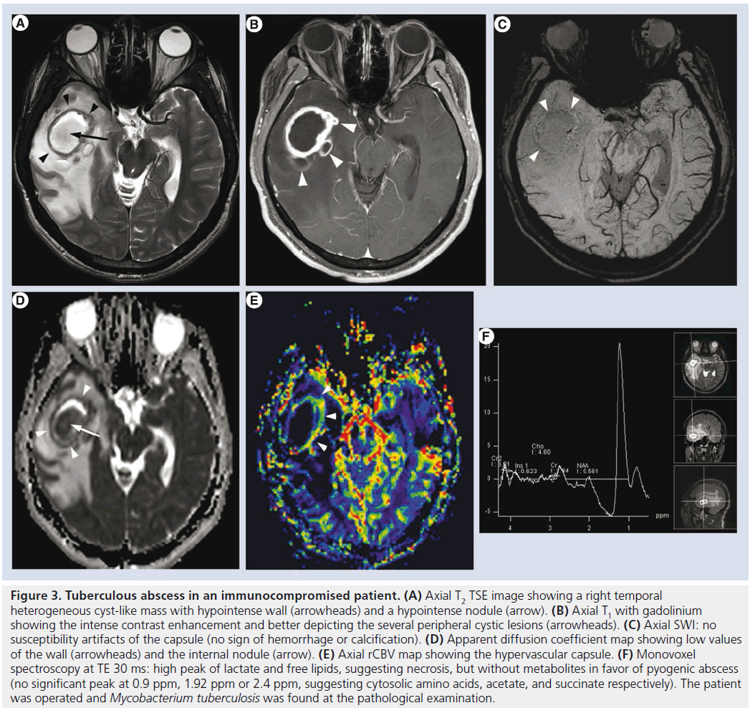
Figure 3.Tuberculous abscess A) Axial T2 TSE image showing a right temporal heterogeneous cyst-like mass with hypointense wall (arrowheads) and a hypointense nodule (arrow).
(B) Axial T1 with gadolinium showing the intense contrast enhancement and better depicting the several peripheral cystic lesions (arrowheads).
(C) Axial SWI: no susceptibility artifacts of the capsule (no sign of hemorrhage or calcification).
(D) Apparent diffusion coefficient map showing low values of the wall (arrowheads) and the internal nodule (arrow).
(E) Axial rCBV map showing the hypervascular capsule.

Slide 43
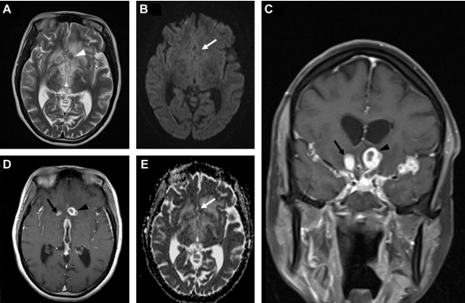
Figure: Tuberculoma associated with tubercular meningitis.
T2-weighted (A), DWI (B), gadolinium enhanced T1-weighted coronal (Gd-MR) (C) and axial (D), ADC map (E) magnetic resonance images.
The central part of the tuberculomas shows mildly hyperintensity in T2-weighted image (white arrowhead) (A), isointensity in DWI (B) and ADC map (white arrows) (E) with intermediate ADC value.
At Gd-MRI images (C, D), the tuberculomas appears as rim-enhancing mass with thick margins. It is associated with tuberculous meningitis that typically affects the basal meninges, and ependymitis of the third ventricle; there are also tuberculous granuloma (black arrow) and other tuberculomas adjacent to the basal sylvian fissure.

Slide 44
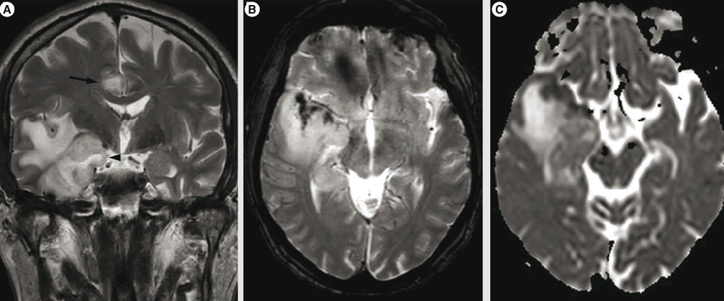
Figure : Herpetic encephalitis.
Coronal T2 image: hyperintensity of the right temporal lobe with mass effect and uncal herniation (arrowhead); note also the involvement of the right cingular gyrus (arrow).
Axial gradient echo T2 image: hypointensity of the anterior temporal cortex, in favor of hemorrhagic transformation.
Apparent diffusion coefficient map: reduced values in the anterior temporal cortex (arrowhead) and increased water diffusion in the subcortical white matter.

Slide 45
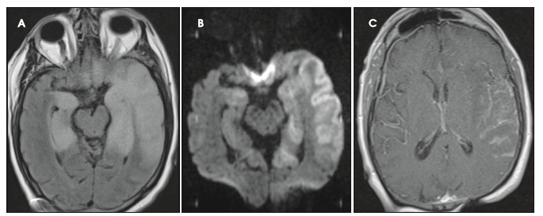
Figure: Herpes simplex virus (HSV) encephalitis.
Axial FLAIR image (A) demonstrates gyral swelling and signal abnormality involving both grey and white matter of bilateral mesial temporal lobes and frontal straight gyri as well as the lateral left temporal lobe.
Diffusion-weighted image (B) shows cortical restricted diffusion in the same areas.
Post-contrast T1-weighted image (C) shows leptomeningeal and parenchymal enhancement in the left perisylvian region suggesting meningoencephalitis.

Slide 46
Fluid Attenuated Inversion Recovery Sequence hyperintensity (A) involving right temporal lobe (black arrow) in a patient with Herpes simplex virus encephalitis, diffusion weighted imaging (B) in a patient with Japanese encephalitis showing restricted diffusion in bilateral basal ganglia.

Slide 47
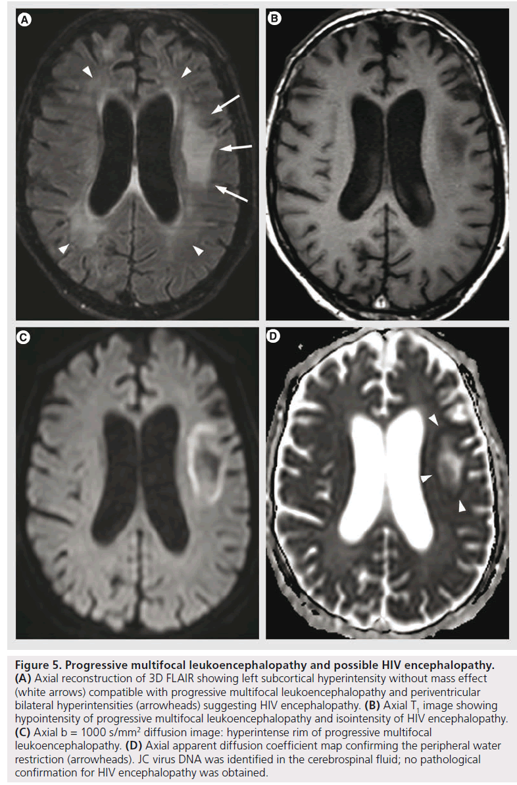
Figure : Progressive multifocal leukoencephalopathy and possible HIV encephalopathy.
Axial FLAIR showing left subcortical hyperintensity without mass effect (white arrows) compatible with progressive multifocal leukoencephalopathy and periventricular bilateral hyperintensities (arrowheads) suggesting HIV encephalopathy.
Axial T1 image showing hypointensity of progressive multifocal leukoencephalopathy and isointensity of HIV encephalopathy.
DWI: hyperintense rim of progressive multifocal leukoencephalopathy.
Axial apparent diffusion coefficient map confirming the peripheral water restriction (arrowheads).

Slide 48
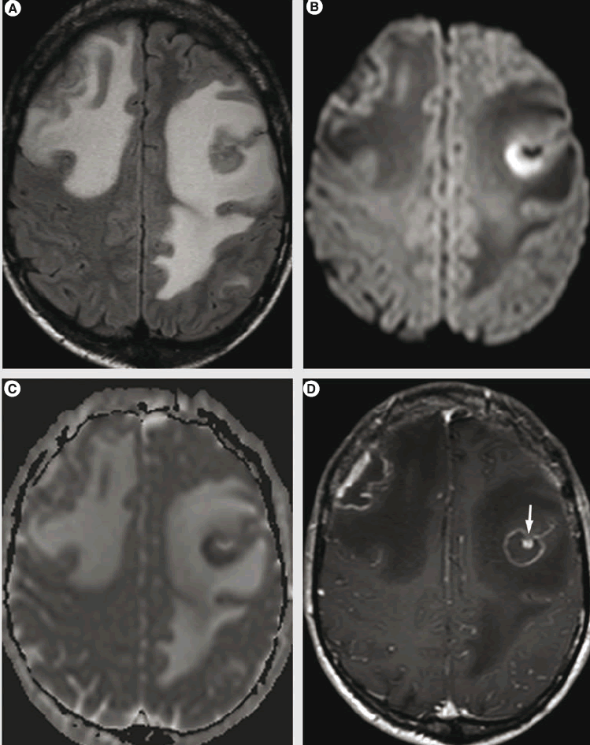
Figure: Toxoplasmosis in an immunocompromised patient.
Axial FLAIR image showing bilateral frontal lesions surrounded by vast areas of hyperintensities suggesting vasogenic edema.
Axial DWI image: hyperintense left frontal lesion; note that the right frontal lesion is isointense on diffusion-weighted imaging.
Apparent diffusion coefficient map confirming water restriction in the left frontal lesion.
Axial gadolinium-enhanced T1 shows the two frontal lesions with peripheral irregular enhancing rim; note the left lesion presents the ‘eccentric target sign’ (arrow), strongly suggestive of the diagnosis.

Slide 49
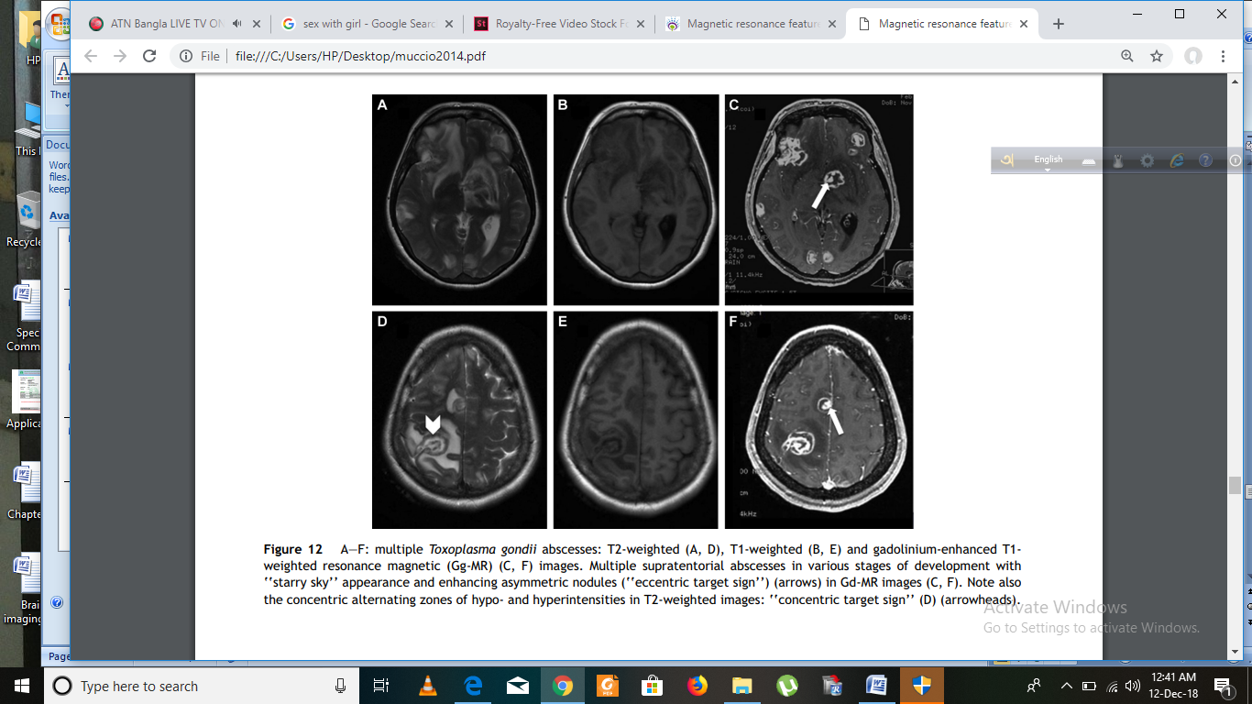
Figure: Multiple Toxoplasma gondii abscesses.
T2-weighted (A, D), T1-weighted (B, E) and gadolinium-enhanced T1- weighted resonance magnetic (Gd-MR) (C, F) images.
Multiple supratentorial abscesses in various stages of development with ‘‘starry sky’’ appearance and enhancing asymmetric nodules (‘‘eccentric target sign’’) (arrows) in Gd-MR images (C, F).
Note also the concentric alternating zones of hypo- and hyperintensities in T2-weighted images: ‘‘concentric target sign’’ (D) (arrowheads).

Slide 50
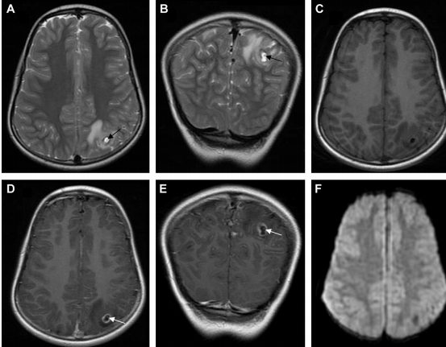
Figure: Neurocystercosis in colloidal-vesicular stage.
T2-weighted axial (A) and coronal (B), T1-weighted axial (C), gadolinium-enhanced T1-weighted axial (Gd-MR) (D) and coronal (E) MR images, DWI (F). At Gd-MR images (D, E) the lesion shows a rim-enhancing mass and in T2-weighted images the capsule is hypointense (A, B).
The MR images show the scolex as a hypointense eccentric nodule in T2 (black arrows) and enhanced nodule in Gd-MR (white arrows).
The central part of the lesion appears hypointense in DWI (E), finding that is consistent with increased diffusion.

Slide 51
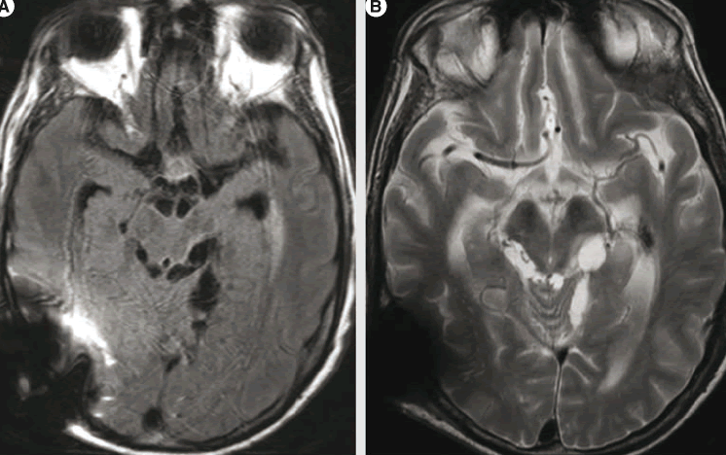
Figure 7.Racemose cysticercosis. Axial FLAIR (A) and T2 (B) showing multiple cyst-like lesions in the basal cisterns; the right temporo-occipital hypointense image is an artifact induced by the ventriculo-peritoneal derivation valve for hydrocephalus

Slide 52
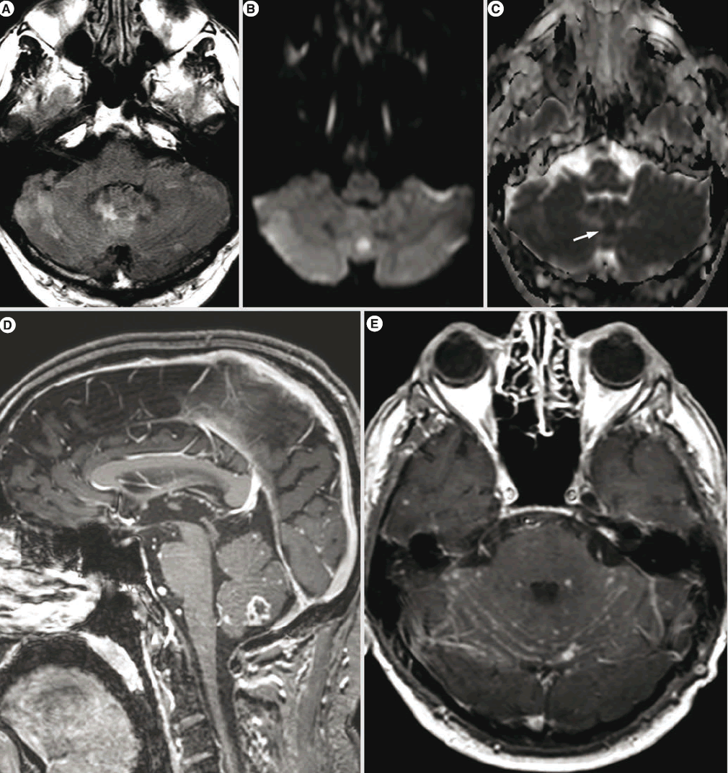
Figure : Cryptococcus infection in an immunocompromised patient.
(A) Axial FLAIR image shows multiple patchy hyperintensities in the posterior fossa.
(B) Axial b = 1000 s/mm2 showing focal cerebellar hyperintensity.
(C) Apparent diffusion coefficient map confirming the water restriction (arrow).
(D) Sagittal Gd-enhanced T1: cerebellar lesion with irregular peripheral enhancement (cryptococcoma) and multiple punctate superficial lesions.
(E) Axial gadolinium-enhanced T1 showing irregular leptomeningeal contrast enhancement and multiple punctate superficial lesions (possibly small cryptococcomas).

Slide 53
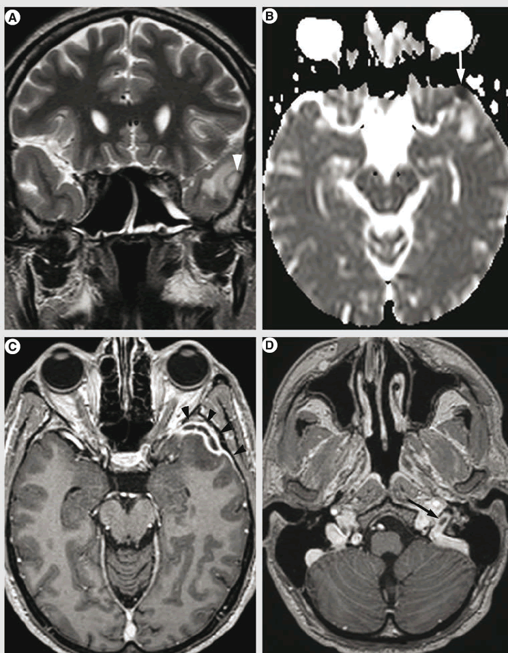
Figure : Subdural empyema and jugular bulb venous thrombosis in a patient with infective endocarditis.
Coronal T2 showing a small left temporal subdural collection (arrowhead) surrounded by cerebral edema.
(B) Axial ADC map: the pyogenic content is confirmed by low apparent diffusion coefficient values (arrow).
Axial Gd enhanced in TW1: peripheral contrast enhancement and dural thickening (arrowheads).
(D) Axial Gd-enhanced T1: partial opacification defect in the left jugular bulb (arrow) suggesting venous thrombosis.

Slide 54
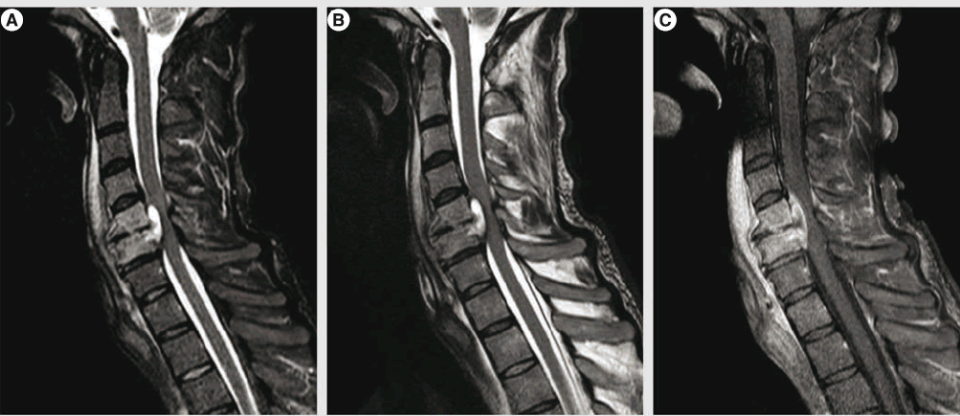
Figure :Spinal epidural abscess complicating C5–C6 bacterial spondylodiscitis.
(A) Sagittal short tau inversion recovery: anterior epidural lesion with hyperintense content and mass effect on the spinal cord; note also the hyperintensities of the medullary bone of C5 and C6 vertebral bodies, discal thinning and prevertebral infiltration.
(B) Sagittal T2 showing similar features of the epidural lesion, but the abnormalities of the medullary bone are hardly visible.
(C) Sagittal contrast-enhanced fat saturated T1: the epidural lesion presents a central part without enhancement, in favor of abscess; no abscess in the prevertebral infiltration; slight contrast enhancement of the C5–C6 disc and obvious contrast enhancement of the vertebral bodies.

Slide 55
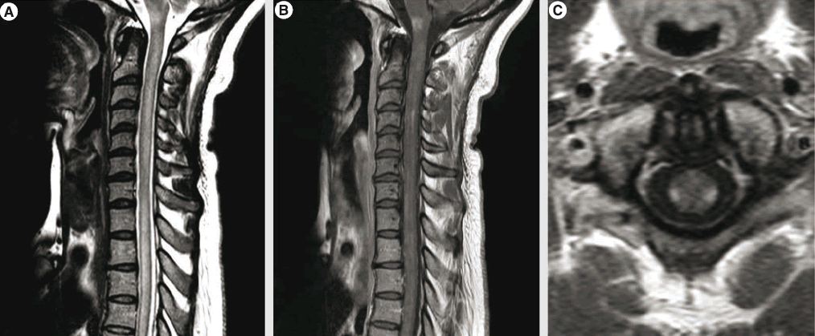
Figure : Viral myelitis with medulla oblongata involvement. (A) Sagittal T2: diffuse hyperintensity in the cervical and upper thoracic spinal cord with slight mass enhancement; note also the involvement of the medulla oblongata. (B) Sagittal contrast-enhanced T1: patchy and diffuse contrast enhancement.
(C) Axial contrast-enhanced T1: bilateral contrast enhancement of the lateral tracts.

Slide 56
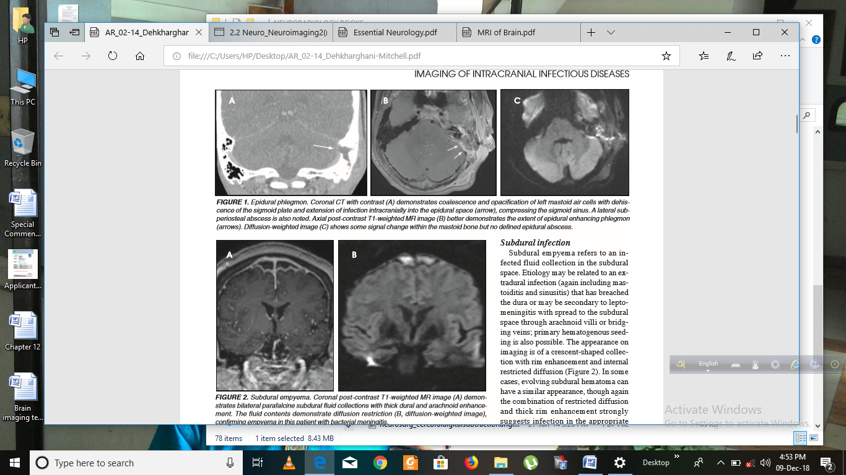
Figure: Epidural phlegmon.
Coronal CT with contrast (A) demonstrates coalescence and opacification of left mastoid air cells with dehiscence of the sigmoid plate and extension of infection intracranially into the epidural space (arrow), compressing the sigmoid sinus. A lateral subperiosteal abscess is also noted.
Axial post-contrast T1-weighted MR image (B) better demonstrates the extent of epidural enhancing phlegmon (arrows).
Diffusion-weighted image (C) shows some signal change within the mastoid bone but no defined epidural abscess.

Slide 57
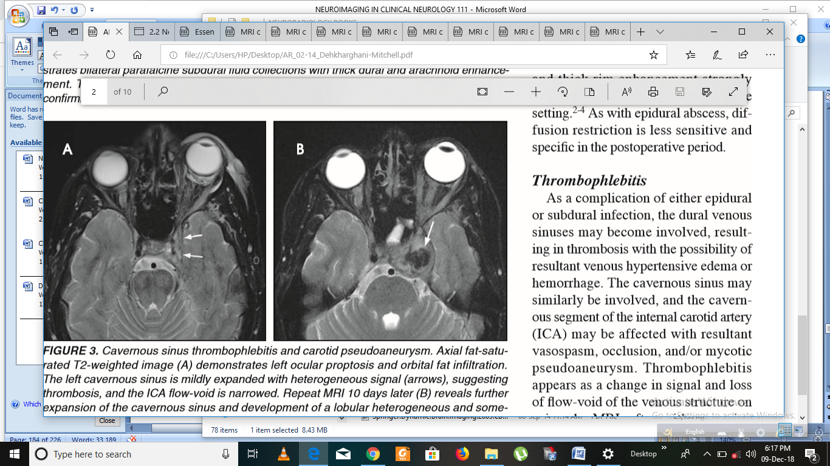
Figure: Cavernous sinus thrombophlebitis and carotid pseudoaneurysm.
Axial fat-saturated T2-weighted image (A) demonstrates left ocular proptosis and orbital fat infiltration. The left cavernous sinus is mildly expanded with heterogeneous signal (arrows), suggesting thrombosis and the ICA flow-void is narrowed. Repeat MRI 10 days later
(B) reveals further expansion of the cavernous sinus and development of a lobular heterogeneous and somewhat lamellated mass of low signal (arrow) contiguous with the ICA flow-void, consistent with a mycotic pseudoaneurysm.

Slide 58
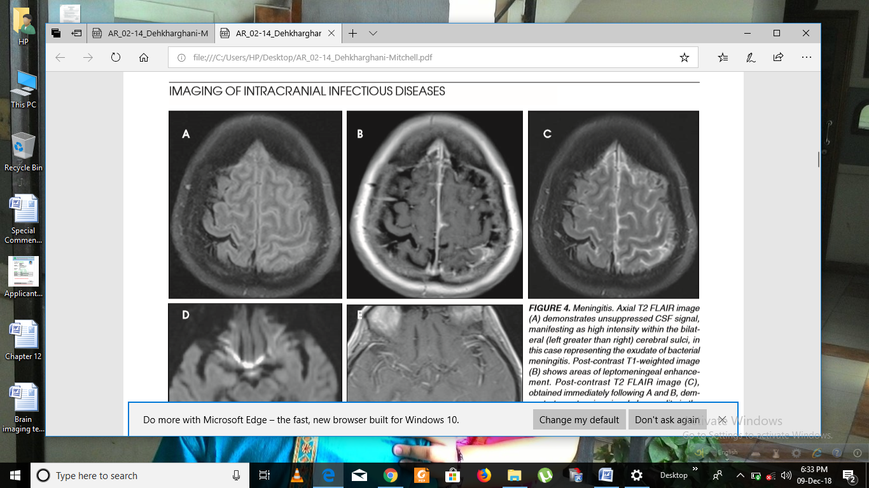
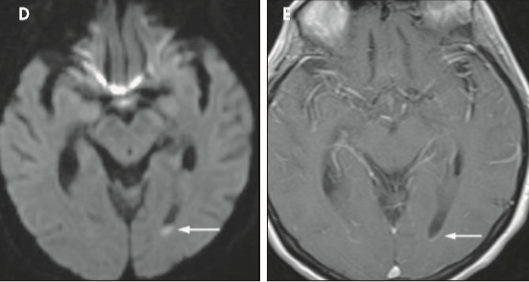
E
Figure: Meningitis.
Axial T2 FLAIR image (A) demonstrates unsuppressed CSF signal, manifesting as high intensity within the bilateral (left greater than right) cerebral sulci, in this case representing the exudate of bacterial meningitis. Post-contrast T1-weighted image (B) shows areas of leptomeningeal enhancement.
Post-contrast T2 FLAIR image (C), obtained immediately following A and B, demonstrates extensive signal abnormality in the sulci and leptomeninges with greater conspicuity.
Axial diffusion-weighted (D) and postcontrast T1-weighted (E) images in a different patient with bacterial meningitis demonstrate ependymal enhancement in the occipital horns of both lateral ventricles with layering exudate on the left (arrows), indicating ventriculitis/ependymitis.

Slide 59

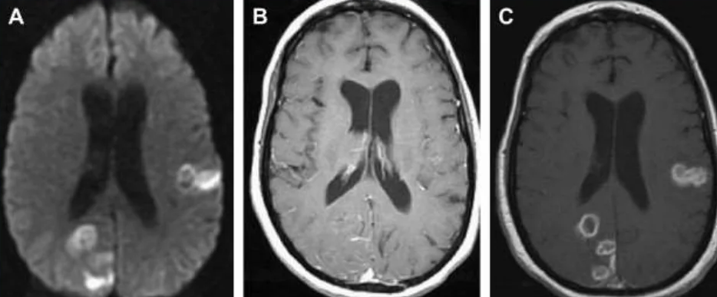
Cerebritis → Cerebral abscess
Figure: Progression from cerebritis to abscess . (A) Axial DWI sequence demonstrates areas of restricted diffusion in the left temporal lobe and posterior right cerebral hemisphere but T1 +Gd (B) images demonstrate some poorly defined enhancement.
C. Follow up axial T1+C sequence 7 days later demonstrates progression to rim enhancement typical of abscess formation

Slide 60
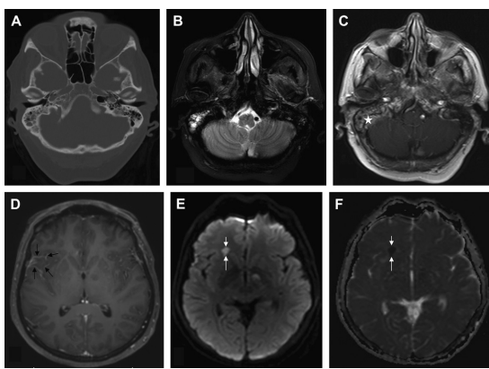
Mastoiditis with meningitis and cerebritis
Fig. Right-side mastoiditis with meningitis and cerebritis. Axial CT (A), T2-weighted MR imaging (B) and postcontrast T1WI (C, D) showing right mastoiditis (white asterisk), with focal leptomeningitis in the right sylvian cistern region (black arrows). Focal area of cerebritis (white arrows) is seen in the right frontal lobe, with restricted diffusion on DWI (E) and ADC map (F); no obvious enhancement is seen on postcontrast image (D).

Slide 61
Conclusion
A multitude of infectious agents are responsible for various clinical pictures and imaging features.
Although this extreme heterogeneity limits the radiological specificity, MR imaging remains an invaluable tool for detection, characterization and follow-up of CNS infections.

