Slide 1

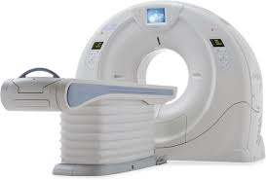
Basics of CT brain
Prof. Dr. Aminur Rahman
FCPS (Med), MD(Neuro) ,FRCP (Edin),
FINR (Switzerland), FACP (USA), FICP(India)
Trained Interventional Neuroradiology (Thailand)
Professor and Head
Department of Neurology
Sir Salimullah Medical College

Slide 2
Learning objectives
Introduction of Neuroimaging
Basic principles of CT scan
Normal neuroanatomy on Head CT Scans
Approach to Review a CT scan

Slide 3
A. Introduction of Neuroimaging

Slide 4
Neuroimaging
Neuroimaging or brain imaging is the use of various techniques to either directly or indirectly image the structure, function / pharmacology of the nervous system.
Neuroimaging plays a pivotal role in the diagnosis of central nervous system (CNS) disorders.
Main modalities of neuroimaging techniques are CT scan and MRI.

Slide 5
Classification of Neuroimaging
It falls into two broad categories:
Structural imaging:
It deals with the structural lesion of intracranial disease (e.g. stroke, tumor, infection, demyelinating disease etc.) and injury.
B. Functional imaging :
It is used to diagnose metabolic diseases and as well as degenerative diseases of brain ( e.g. Alzheimer's disease) and also for neurological and cognitive psychology research.

Slide 6

Indications of Neuroimaging
To investigate a patient who has or may have a neurological disorders such as stroke, headache, syncope, seizure disorder etc.
For stereotactic surgery or radiosurgery for treatment of intracranial tumors, arteriovenous malformations and other surgically treatable conditions.
To diagnose metabolic diseases and degenerative diseases (such as Alzheimer's disease, Parkinson’s diseases etc.) and also
For neurological and cognitive psychology research.

Slide 7
Techniques of Neuroimaging
Computed tomography (CT) or Computed Axial Tomography Scan (CAT Scan)
Magnetic resonance imaging(MRI)
Functional magnetic resonance imaging(fMRI)
Magnetoencephalography( MEG)
Positron emission tomography(PET)
Single-photon emission computed tomography(SPECT)
Computed tomography angiography(CTA)
Magnetic resonance angiography(MRA)
Magnetic resonance venography(MRV)
MR Neurography / MR Imaging of Peripheral Nerves (PNI)
Cerebral Digital Substraction angiography (DSA).

Slide 8
B. Basic principles of CT Scan

Slide 9
Introduction
CT Scan is an imaging modality that uses X-rays to obtain structural and functional information about the human body.
The word Tomography is derived from a Greek word where tomos represents "slice" or section and graphia meaning "description".
CT scans can expose patients to levels of radiation 100-500 times higher than traditional x-rays, with higher radiation doses producing better resolution imaging.

Slide 10
History
Sir Godfrey Hounsfield-1972
Nobel prize in 1979
Original scanners took approximately 6 minutes to perform a rotation (one slice) and 20 minutes to reconstruct.

Slide 11
Must for every physician
CT head is an extremely important investigation used routinely in indoor as well as “Accident & Emergency” patients.
A quality physician needs to be able to accurately interpret and act upon certain findings without specialist (e.g., Radiologist) advise, because these disease processes are time dependant and demand immediate action.

Slide 12
Indications of CT Scan of brain
Head injury or skull fractures,
Stroke,
Suspected hydrocephalus,
Suspected intracranial hematoma,
Evaluation of Headaches,
Diseases or malformations of the skull.
Initial evaluation for space-occupying lesions
Seizures and
Unexplained change in mental status.

Slide 13
Indications for CT Brain with IV contrast
Tumours
Infections (meningeal enhancement, abscess)
Inflammation (MS, granulomatous diseases etc)

Slide 14
Contraindications of CT scan of Head
CT scan has no absolute contraindications.
Caution is indicated in pregnant women, particularly during the first trimester to avoid fetal abnormalities.
Repeated x-ray exposure may increase the patient's risk for cancer.

Slide 15
Advantages of CT scan (over MRI):
Cheaper.
More available.
Quick. It takes about few minute. So it is the method of choice for restless or critical patients and for babies.
Bony abnormalities and calcifications can be visualized.
It can detect acute (< 2 weeks) haemorrhage.

Slide 16
Disadvantages of CT scan:
Radiation hazard, so relative contraindicated in pregnancy.
Good resolution cannot be achieved in all planes. In fact, only axial planes have good resolution.
Posterior fossa of head and spinal canal are not well visualised because X-ray cannot penetrate bone.
Poorer resolution. CT cannot detect lesions< 5 mm, whereas MRI can detect up to 1 mm. But now a days 64 slice CT scan can take 1 mm section.
CT cannot detect inflammatory lesions.

Slide 17
Basic principles of CT imaging:
Uses X rays applied in sequence of slices across the organ
Images reconstructed from X ray absorption data
X ray beam moves around the patient in a circular path

Slide 18
Basic principles of CT imaging…
X rays are produced by CT machine, which are absorbed by different tissues in different degrees.
CT machine has X-ray source and detectors which are 180 degrees around each other and move 360 degrees around the patient

Slide 19
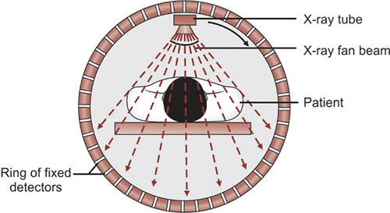
Basic principles of CT imaging…

Slide 20
Basic principles of CT imaging…
CT scan provides a 3D display of the intracranial anatomy built up from a vertical series of transverse axial tomograms.
Using computer processing, slice thickness (typically ranging from 3-5 mm for routine scanning) can be varied according to the level of details that is required for image interpretation.

Slide 21
Basic principles of CT imaging…
Modern-day helical or spiral scanners obtain power via slip ring technology, thus allowing continuous tube rotation as the patient moves through the scanner automatically.
This allows a volume of data to be acquired in a single rotation, with the benefits of faster scanning, faster patient output and less re-imaging as patient movement artifact is reduced.

Slide 22
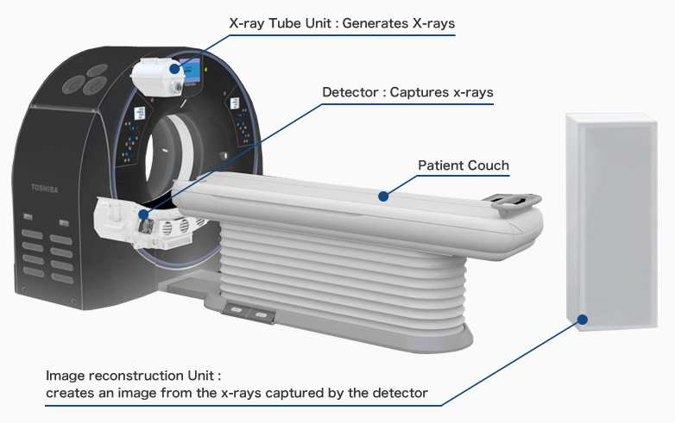
CT Scan Set-Up Diagram

Slide 23
Process of CT imaging
3 steps:
Scan
Scan data
Digital image

Slide 24
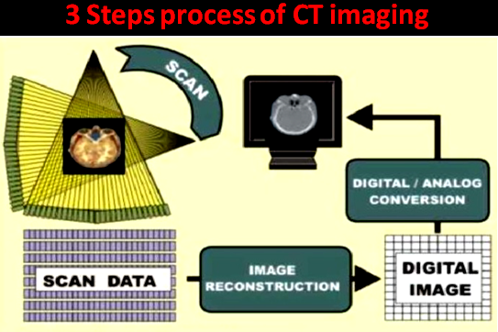

Slide 25
Types of CT Scan techniques
Conventional CT Scan
Spiral or helical CT Scan

Slide 26
A. Conventional CT Scan
X-ray tube rotates around the patient to collect data from a single slice of tissue-followed by table indexing so the next contiguous slice can be collected.
Limitations of conventional CT:
Longer exam time
Pertinent anatomy omission(misregistration)
Inaccurate generation of 3-d images
Difficulty in maintaining high contrast enhancement

Slide 27
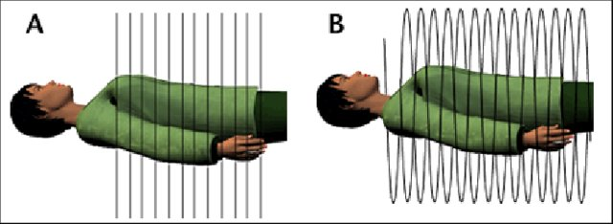
Types of CT Scan techniques
Conventional CT
Spiral CT
Figure: Types of CT Scan techniques

Slide 28
B. Spiral CT scan
A spiral (or helical) CT scan is a new kind of CT. During a spiral CT, the x-ray machine rotates continuously around the body, following a spiral path to make cross-sectional pictures of the body.
This allows more images to be made in a shorter time than with older CT methods.

Slide 29
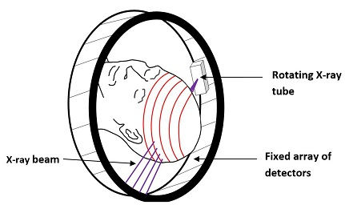
Spiral CT scan
Figure: Spiral /helical CT scanning technique comprising a rotating x-ray tube and a fixed array of detectors

Slide 30
Advantages of Spiral over Conventional CT
It can be used to make 3–dimensional pictures of areas inside the body;
It may detect small abnormal areas better than conventional CT; and
It is faster, so the test takes less time than a conventional CT.

Slide 31
CT Slices
The commonly available CT slice counts include 16, 32, 40, 64, and 128 slices, with less common ones providing up to 256 and 320 slice CT scanners.
256- or 320-slice computed tomography (CT) systems are used for cardiac imaging.
The 4 to 8 slice scanners are slowly being withdrawn from the market.

Slide 32
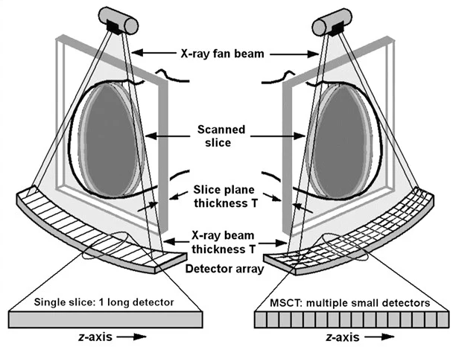
CT Slices….

Slide 33
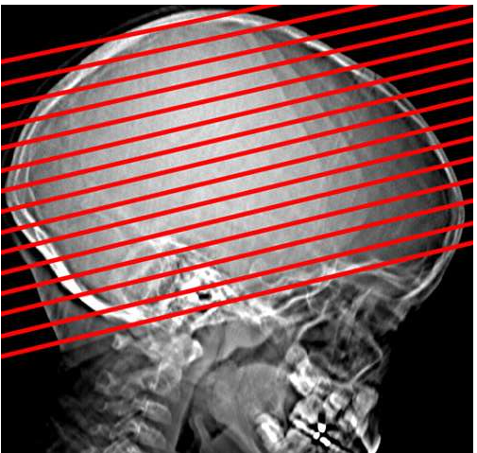
Slice thickness may vary, but it is between 3 and 5 mm for a routine Head CT
CT Slices….

Slide 34
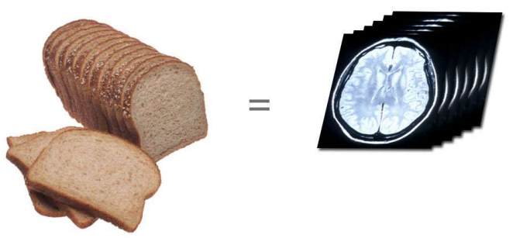
CT Slices….
Slice thickness is between 3 and 5 mm for a routine head CT

Slide 35
Attenuation Coefficient
The tissue contained within each image unit (called a pixel) absorbs a certain proportion of the x-rays that pass through it (e.g., bone absorbs a lot, air almost none).
The ability to block x-rays as they pass through a substance is known as Attenuation.
The amount of attenuation is relatively constant in a given body tissue, and is known as that tissue’s attenuation coefficient.

Slide 36
Hounsfield scale
In CT, these attenuation coefficients are mapped to an arbitrary scale of between −1000 Hounsfield units (HU) (air) and +1000 HU (bone).
This scale is the Hounsfield scale.

Slide 37
Appearance and Density of Tissues on CT Head
Appearance: Black → → → → → → → → → → White −1000 HU → → → → → → → → +1000 HU Air, fat, CSF, white matter, gray matter, acute hemorrhage, bone Important Densities: Air = −1000 HU Water = 0 HU Bone = +1000 HU CSF, Cerebrospinal fluid; HU, Hounsfield units.

Slide 38
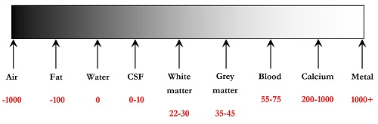
Hounsfield scale…
Figure : Hounsfield scale ranging from -1000 to + 1000

Slide 39
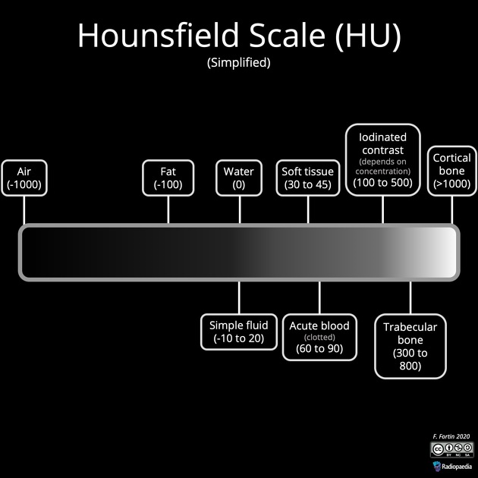
Hounsfield scale….

Slide 40
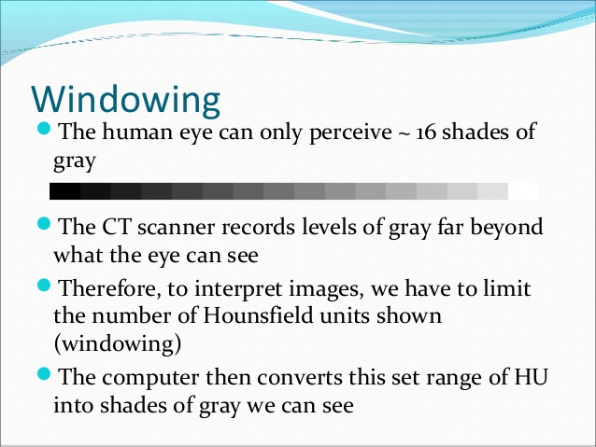
Windowing
Windowing is the process of using the calculated Hounsfield units to make an image.
The various radiodensity amplitudes are mapped to 256 shades of gray.
The human eye can only perceive ~ 16 shades of gray.
The CT scanner records levels of gray far beyond what the eye can see.

Slide 41
Windowing….
Therefore, to interpret images, we have to limit the number of Hounsfield units shown (windowing)
The computer then converts this set range of HU into shades of gray for visualization .

Slide 42
Window width & level
Window width:
The range of HU of all tissues of interest
Tissues in this range will be displayed in various shades of gray
Tissues with HU outside the range are displayed as black or white
Window level:
The central HU of all the numbers in the window width

Slide 43
Narrow and wide Window
Wide window:
Defined as 400-2000 HU best used in areas of acute differing attenuation values, a good example is lungs or cortical tissue, where air and vessels will sit side by side.
Narrow window:
Defined as 50-350 HU are excellent when examining areas of similar attenuation, for example, soft tissue.

Slide 44
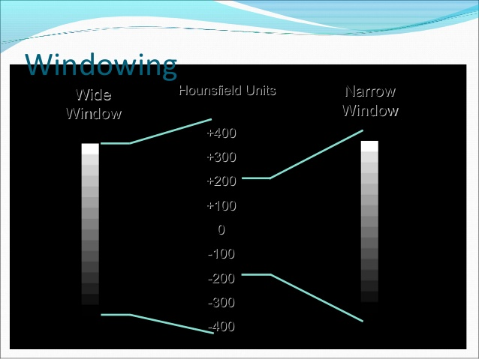
Windowing

Slide 45
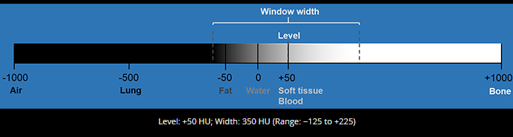
Soft tissue window
A soft tissue window is used to view most organs.
A soft tissue window cannot be used for lung parenchyma, as lung density (−500 HU) is outside range and will appear completely black.

Slide 46
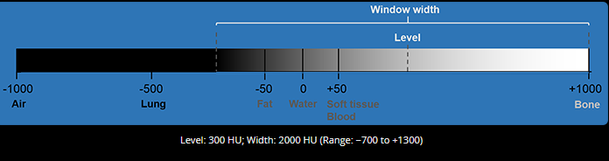
Bone window
A bone window is used to view bone detail. There is good differentiation within the range of high densities found in the bony cortex and medulla.

Slide 47
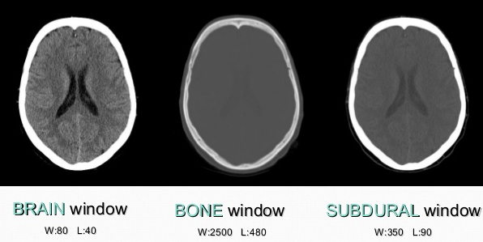
Window examples

Slide 48
CT scan of Head is expressed in terms of density
X-rays are absorbed to different degrees by different tissues .

Slide 49
CT scan Density
Brain parenchyma is the reference density
Isodense: For CT head, normal brain parenchyma is isodense.
Hypodense: Darker than normal brain parenchyma.
Hyperdense: Whiter / Higher density than normal brain parenchyma.

Slide 50
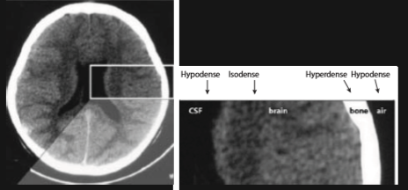
Three basic densities or different shades of grey
Figure: Densities of CT scan

Slide 51
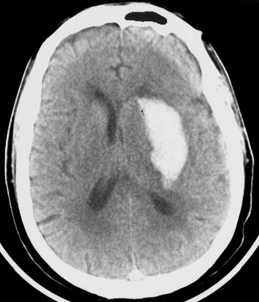
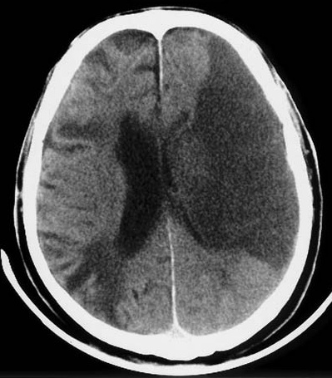
Figure: In CT scan all features are expressed in density ( Hypo-dense, Iso-dense, Hyper-dense
Hemorrhage
Infarct

Slide 52
Types of CT Scan of head / brain
General CT scan | Special CT scan
Tissue window: Here soft tissue is highlighted. Bony window: Here bone and calcifications are highlighted. CT head with contrast: Blood vessels and highly vascularized tissue are visible. | Reconstructed coronal CT scan of head. 3D reconstructed CT scan of head. Plain/Reconstructed CT angiogram of head.

Slide 53
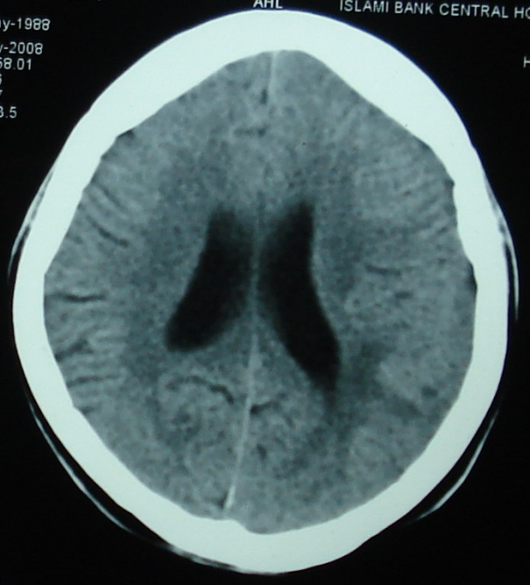
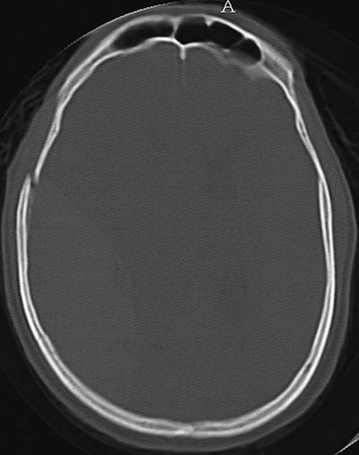
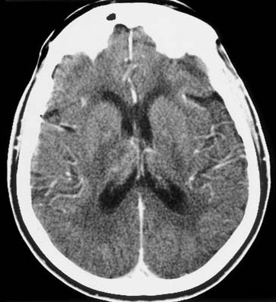
General CT scan of head
Soft tissue window/plain CT
Bony window
Contrast CT

Slide 54
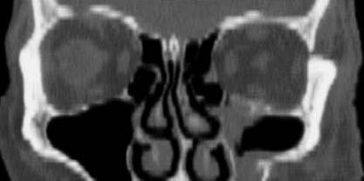
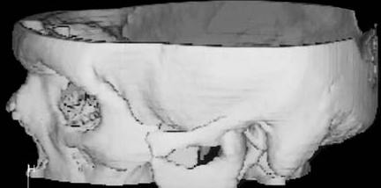
Special CT scan of head
Reconstructed coronal CT head
3D Reconstructed CT head

Slide 55
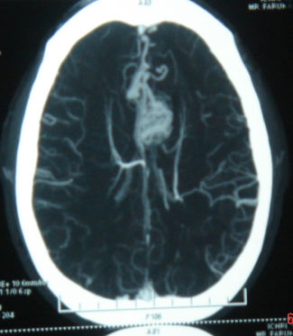
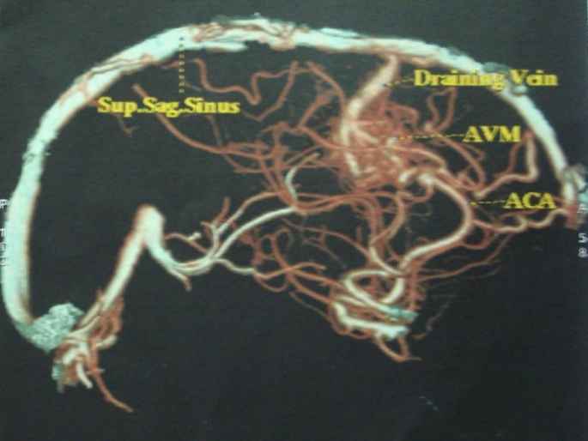
CT angiogram of head
Special CT scan of head
Plain CT angiogram of brain
Reconstructed CT angiogram of brain

Slide 56
Contrast Imaging….
Depending on the structure being imaged, CT scans can be used with and/or without contrast.
Iodine-based IV contrast medium is used for most CTs.
It can be used for a variety of diagnostic purposes, for example:
Used to visualize the cardiovascular system (e.g. investigating for suspected aneurysms, dissections, or atherosclerotic diseases).
Used to identify whether a tumour is malignant.

Slide 57
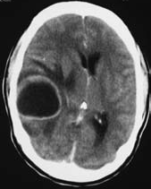
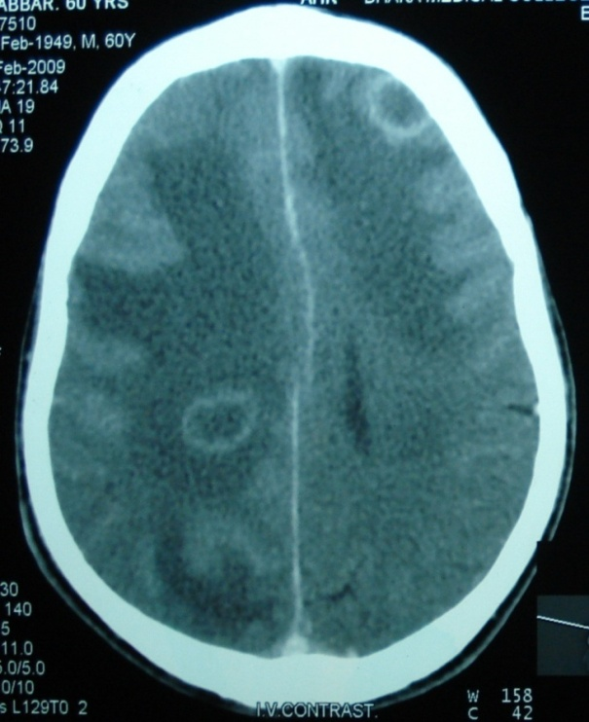
Contrast Imaging….
After approximately 7 minutes after an intravenous injection with iodinated CT contrast, the contrast begins to expel from the body via the urinary system.

Slide 58
Risks of contrast administration
Contrast-induced nephropathy - Creatinine increasing 25% within 3 days, with no other apparent reason. Usually self-limiting but can cause complications of kidney disease. Incidence of ~2% in patients without risk factors (e.g. diabetes)
Anaphylaxis (immediate, within 1 hour)
Allergy (delayed, up to 7 days)

Slide 59
Planes of CT scan
Plane refers to how the picture slices are orientated
Transaxial/ axial plane
used most often for head CT’s
Coronal plane
good for evaluation of pituitary/sella and sinuses
Sagittal plane
rarely used (more common in MRI)

Slide 60
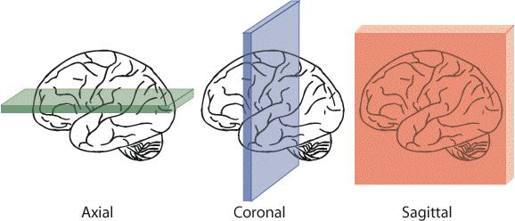
Planes of CT Scan of Brain….
Axial plane is the most important in a head CT

Slide 61
Lesions seen in CT Scan Head
Hypodense (black) lesions | Hyperdense (white) Lesions
Air, e.g., In nasal cavity, paranasal sinuses | Bones
2. Fluid, except blood, e.g., CSF, water. | 2. Acute haemorrhage: Blood pigments ( bilirubin, biliverdin) are radio-opaque.
3. Infarct. | 3. Calcification
4. ISOL. | 4. Contrast material.
5. Old haemorrhage (>2-3 weeks).

Slide 62
C. Normal anatomy on Head CT Scans

Slide 63
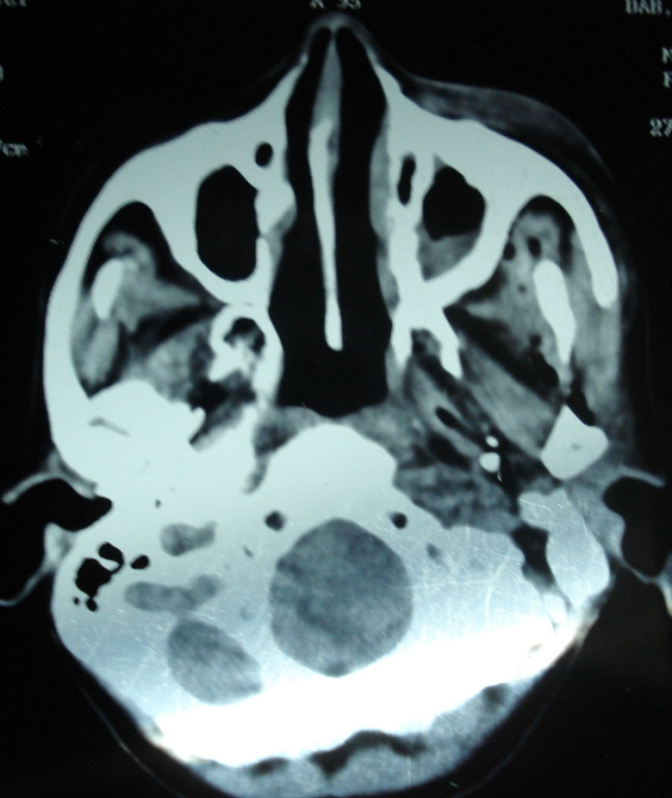
1st section
At Base of the skull level
Nasal septum
Maxillary sinus
Oral cavity
Cervico-medullary junction
Foramen magnum
Base of the skull

Slide 64
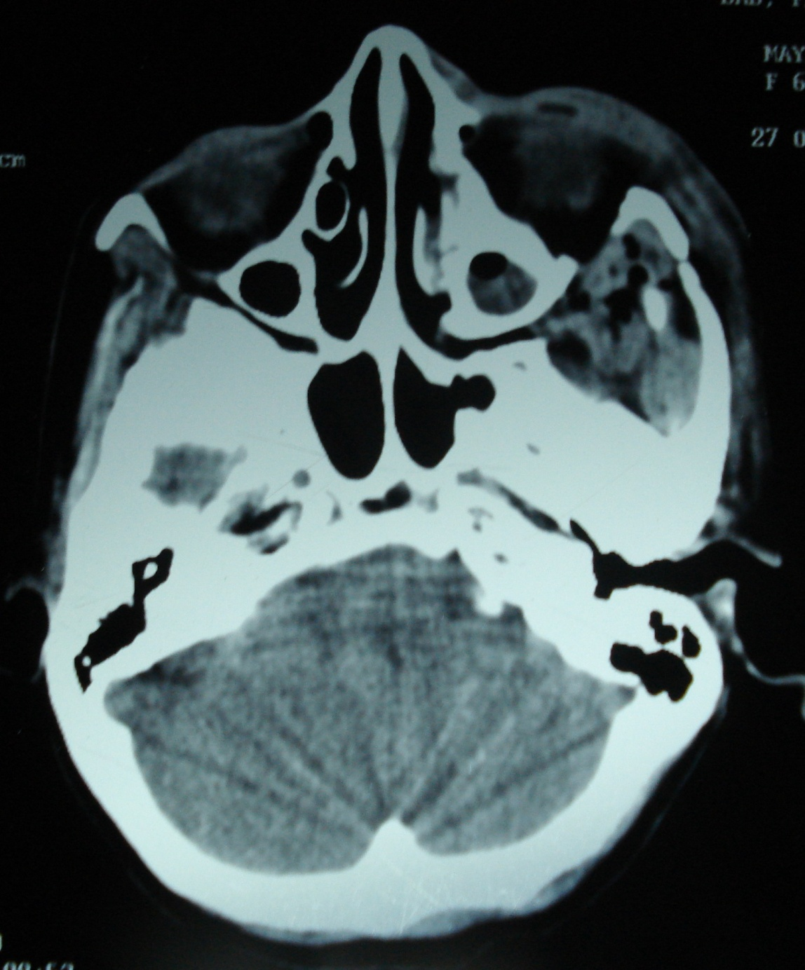
2nd section
At Base of the skull level
Eye ball
Mastoid air cells
Cerebellum

Slide 65
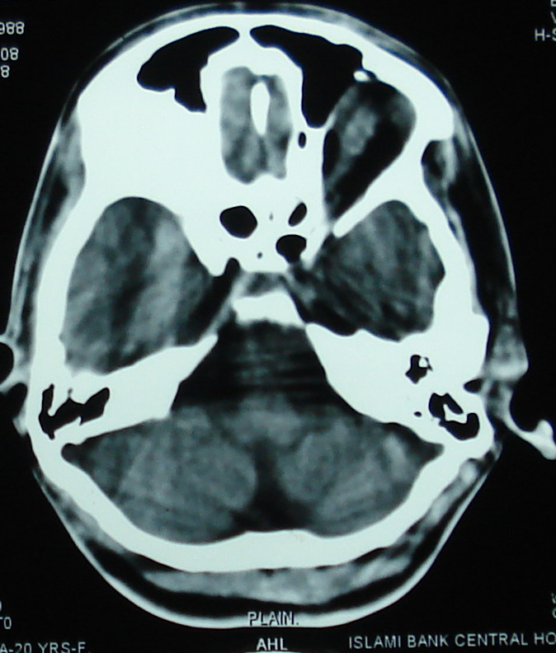
3rd section
At the level of Medulla
Frontal air sinus
Sphenoidal air sinus
Temporal lobe
Medulla oblongata
Cerebellum
Scalp

Slide 66
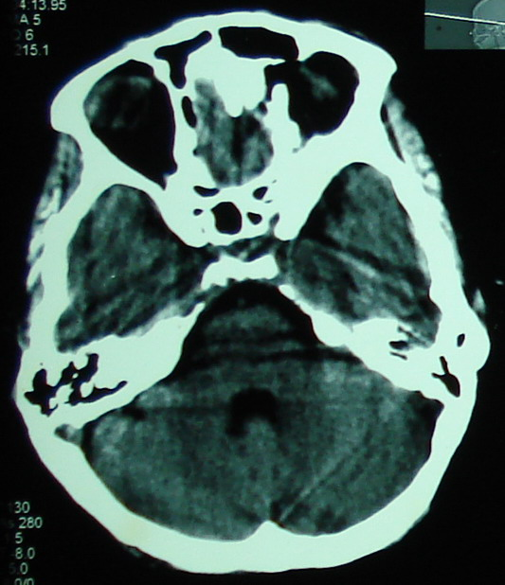
4th section
At the level of lower pons
Orbital cavity
Sphenoidal air sinus
Ant. clinoid
Temporal lobe
Dor. sella
Lower Pons
4th ventricle
Cerebellum

Slide 67
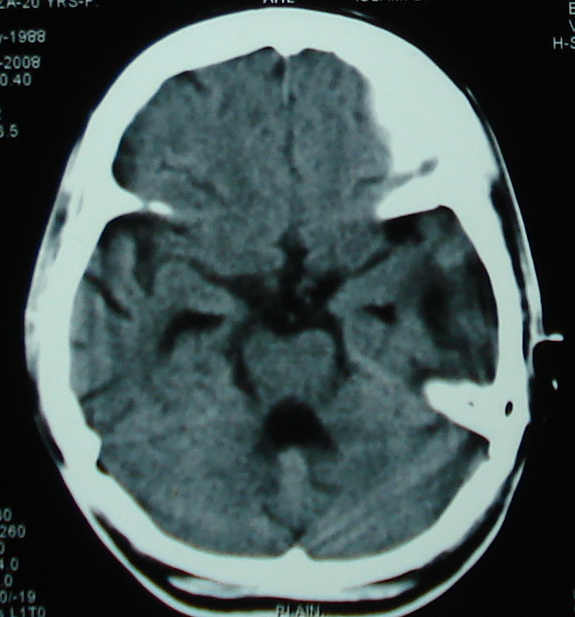
5th section
At the level of mid Pons
Interhemispheric fissures
Chiasmatic / basal cistern
Temporal horn of lat. ventricle
Mid Pons
4th ventricle
Vermis of cerebellum

Slide 68
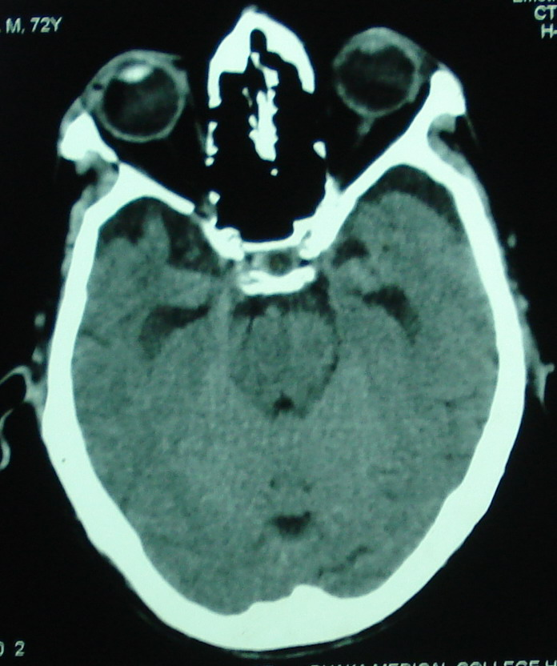
6th section
At the level of superior pons
Nose
Eye ball
Temporal lobe
Pituitary fossa
Basilar artery
Superior Pons
4th ventricle

Slide 69
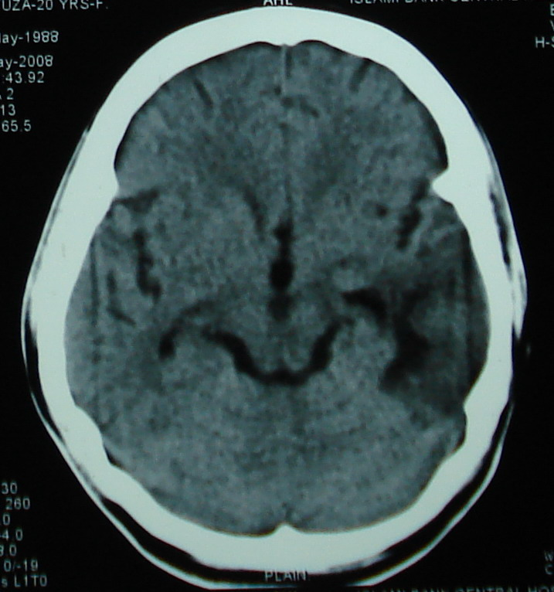
^{7th} section
At the level of Midbrain
Frontal lobe
Sylvian fissure
3rd ventricle
Temporoparietal lobe
Midbrain
Quadrigeminal cistern
Occipital lobe

Slide 70
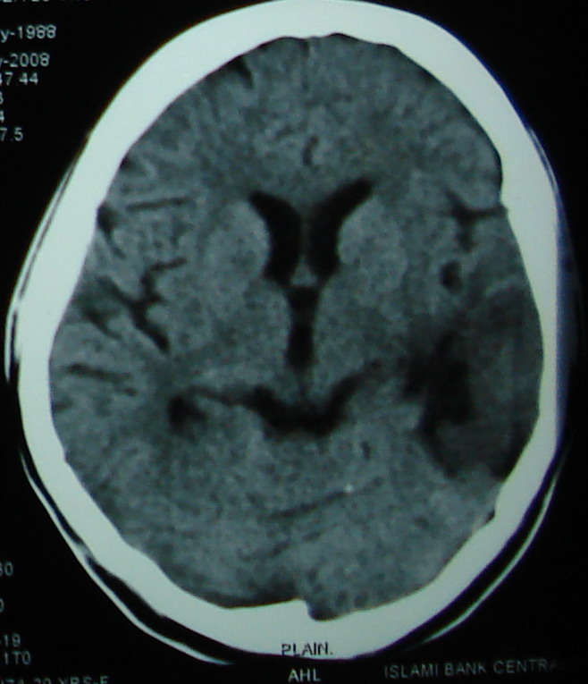
8th section
At the level 3rd ventricle
Ant. / Frontal horn of lateral ventricle
Septum pellucidum
Fornix
3rd ventricle
Trigone
Occipital sinus in falx cerebelli
Internal occipital protuberance

Slide 71
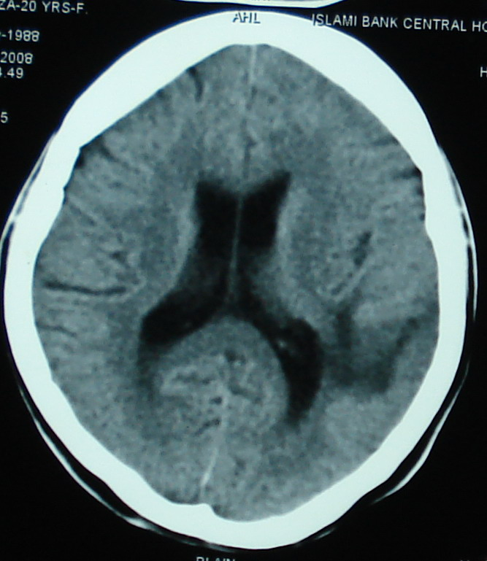
^{9th} section
At the level lateral ventricle
Falx cerebri
Frontal lobe
Lateral ventricle
Body of lateral ventricle
Parietal lobe
Post/Occipital horn of lateral ventricle
Occipital lobe

Slide 72

^{10th} section
At the level lateral ventricle
Falx cerebri
Gyrus
Sulcus

Slide 73
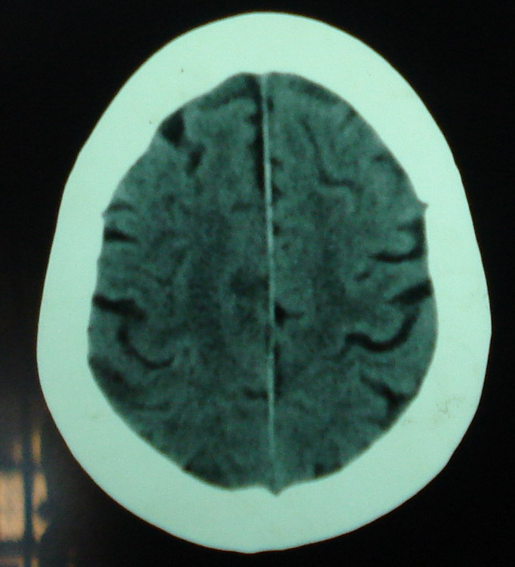
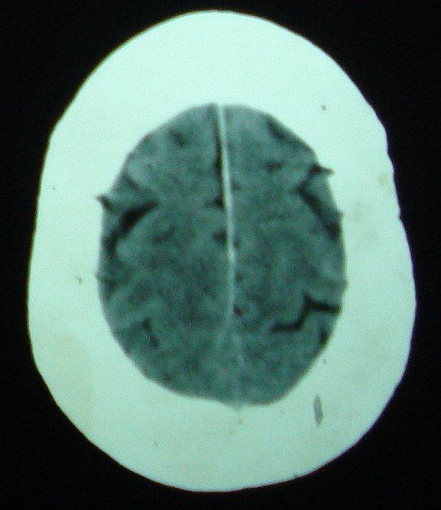
11th, 12th section
Above the ventricular level

Slide 74
Physiological calcifications
Falx cerebri
Choroid plexus ( suspended in the post. horns of lateral ventricle)
Pineal gland (in third ventricle)
Basal ganglia ( speckle calcifications)

Slide 75
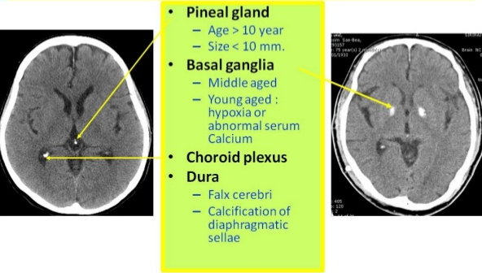
Physiological calcifications

Slide 76
D. Approach to Review a CT scan

Slide 77
Identification of CT
Now we can begin our basic approach to the head CT
Start with the easy stuff:
PATIENT NAME (make sure you have the right patient !!)
MEDICAL RECORD # (MRN)
AGE
DATE OF EXAM

Slide 78
Previous studies
Always check for any previous scans for comparison
Findings can be very subtle
A good way to spot them is to look for changes between the current and previous scans
Even old chest and abdominal films can give you clues to possible brain pathology
i.e. Brain mets from lung cancer

Slide 79
Study parameters
Make note of the study technique:
Anatomic region of scan: head, neck, spine
Slice thickness (mm)
Window level & width
Plane: Transaxial, coronal, saggital
Use of contrast?
Look for the Circle of Willis. It will be enhanced on studies using contrast

Slide 80
Image analysis
Now that you have noted all the basic information about the scan, it’s time to look at the scan itself
Use a systematic order & approach to what you look at
Use the same approach for all scans to ensure that you don’t miss anything

Slide 81
Regions to inspect
Start from the inside and move outwards:
Midline structures & symmetry
Ventricles
Cisterns
Brain parenchyma
Sulci
Sinuses
Bones
Skin/soft tissue

Slide 82
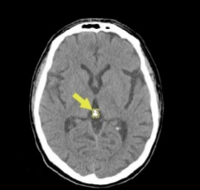
Midline structures
Identify:
Fornix
Falx Cerebri
Pineal gland (usually calcified)
Great vein of Galen

Slide 83
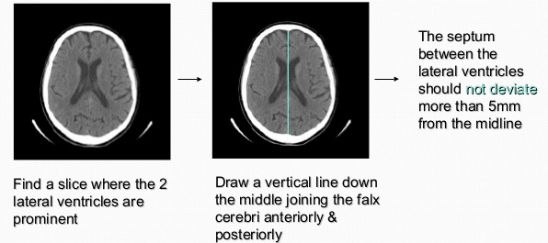
Midline shift
Evaluate for midline shift:

Slide 84
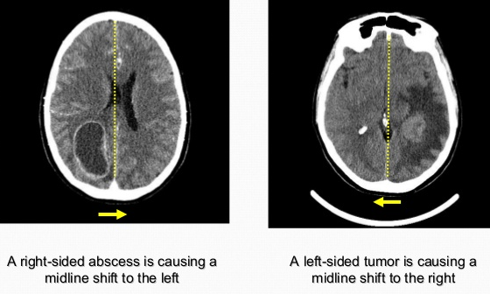
Examples of midline shift

Slide 85
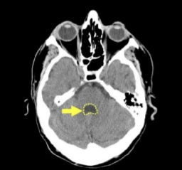
Ventricles
Identify:
Lateral ventricles x 2
Third ventricle
Cerebral aqueduct
Fourth ventricle

Slide 86
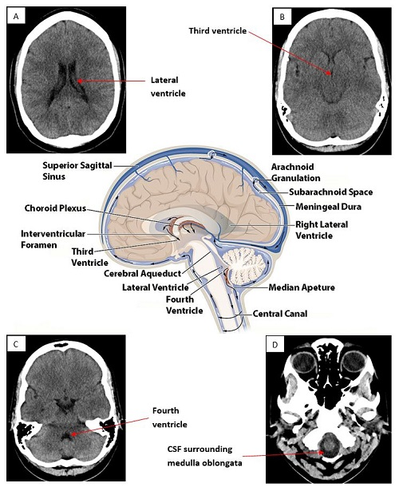
Ventricles

Slide 87
Ventricles
Evaluate for any changes in:
Symmetry
Size
Shape
Density
A displaced ventricle is often the product of mass effect or atrophy

Slide 88
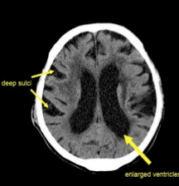
Ventricles
Common pathology:
Mass effect
Atrophy
Hydrocephalus
Intra-ventricular Hemorrhage

Slide 89
Cisterns
The cisterns/ subarachnoid cisterns are spaces within the subarachnoid space where the pia mater and arachnoid membrane are not in close approximation.

Slide 90
Subarachnoid cisterns are:
Cisterna magna: the largest of the subarachnoid cisterns
Circummesencephalic : anterior to the pons
Suprasellar cistern: surrounding the infundibulum
Interpeduncular cistern: between the cerebral crura
Quadrigeminal cistern: superior cistern or cistern of the great cerebral vein
Ambient cistern/ Circummesencephalic : surrounds the back of the midbrain
Cerebellopontine cistern: at the cerebellopontine angle
Premedullary cistern: anterior to the medulla
Sylvian cistern: superficial to the insular cortex

Slide 91
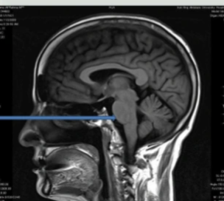
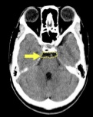
Cisterns….
Prepontine cistern
Figure: Suprasellar cistern

Slide 92
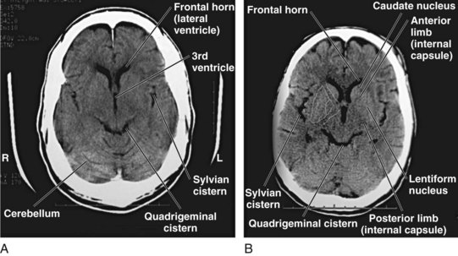
Cisterns….
Figure: Ambient cistern/ Circummesencephalic

Slide 93

Cisterns….

Slide 94

Brain parenchyma – Lobes
First, identify the major lobes:
Frontal lobe
Temporal lobe
Parietal lobe
Occipital lobe

Slide 95

Brain Parenchyma - Brainstem
Then identify:
Midbrain
Pons
Medulla
Cerebellum

Slide 96

Brain parenchyma – Deep structures
Lastly, identify the deep structures:
Corpus Callosum
Caudate
Thalamus
Lentiform Nucleus
Internal capsule
External capsule

Slide 97

Sulci
Identify
Sulci
Sylvian fissures
Central sulcus
Precentral sulcus
Postcentral sulcus

Slide 98

Sulci…
Remember that sulci will become deeper and more prominent with age
Look for blood in the sulci & Sylvian Fissure which are indications of a sub-arachnoid bleed Acute blood in Sylvian fissure Acute blood in sulci

Slide 99

Parenchymal masses
Look for mass lesions
Abscess
Neoplasm
Note how the tumor becomes bright with contrast that dark area of edema
Note the ring enhancing lesion with contrast consistent of an abscess that dark area of edema

Slide 100

Sinuses
Switch to Bone Window to better evaluate the sinuses
Identify:
Superior Sagittal Sinus
Frontal Sinus
Ethmoid Sinus
Sphenoid Sinus
Maxillary Sinus

Slide 101

Sinuses….
Evaluate for any sinusitis: fluid in sinuses
(notice the air/fluid level)

Slide 102
Sinuses….
Also look for any:
Mucosal thickening
Blood in sinuses (especially with history of trauma)
Polyps or mucous retention cysts

Slide 103

Bone
Stay on the Bone Window and look at the bones now
Identify:
Skull
Sutures
Mastoid air cells

Slide 104

Bone….
Evaluate for any:
Fractures
Surgical changes (ie. craniotomies)
Craniotomies

Slide 105

Skin & Soft tissue
Evaluate for any:
Sub-galeal hematoma
Foreign body
Surgical changes
Sub-galeal hematoma

Slide 106

In summery : Approach to Review a CT scan : AABBCS (Mnemonic)
A-Asymmetry
A- Air-filled structures (artifacts/sinuses, mastoid air cells)
B-Blood (subarachnoid, intracerebral, subdural, epidural hematoma)
B- Brain tissue (infarction, edema, masses, brain shift
C- CSF spaces (sulci, ventricles, cisterns, hydrocephalus, atrophy)
S–Skull and scalp (fractures, Skull metastases)

Slide 107

Normal CT of Brain
Ventricles are normal sized, the grey versus white distinction is clear.
Midline is straight.
Sulci are symmetrical on both sides.
Skull is intact with no scalp edema

Slide 108
Abnormalities in CT Scan Head
Common abnormalities (95%) | Un Common abnormalities(5%)
Infarct : a. Cortical b. Sub-cortical c. Cerebellar d. Brainstem Haemorrhage Space occupied lesion (SOL) | Hydrocephalus: a. Obstructive. b. Non obstructive. Diffuse brain oedema. Abnormal calcification.

Slide 109


Artifacts of CT scan
Ring Artifact
Noise artifact

Slide 110


Artifacts of CT scan…
Metal Artifact
Beam Hardening

Slide 111

Artifacts of CT scan….
Figure: Motion artifact

Slide 112
Description of a CT Scan head
This is a CT Scan of head which is non contrast tissue window in multiple axial plane of a -------- years old male/female patient showing a hyper/hypo dense lesion which is ovoid/irregular/------- shape surrounded by a hypodense rim situated in right/ left temporo-parietal/ Ganglio thalamic/------------ region.
There is pressure effect as evidenced by compression of lateral ventricle at that side.
(If ) contrast shows enhancement of lesion or ring enhancement .

Slide 113

Thanks

