Slide 1



Augmentation in Restless Leg Syndrome: Management Challenges
Prof. Dr. Aminur Rahman
MBBS, FCPS (Medicine), MD (Neurology), FRCP (Edinburg),
FINR (Switzerland), FACP (USA),FICP(India)
Prof. & Head
Department of Neurology
Sir Salimullah Medical College, Dhaka , Bangladesh

Slide 2


Name :- Dr. Aminur Rahman
MBBS, FCPS (Medicine), MD (Neurology),FRCP (Edinburg),
FINR (Switzerland), FACP (USA), FICP(India)
Clinical &Interventional Neurologist and Internist
Major Achievement :-He has published more than 65 research papers in reputed journals, both national and international. He is also the author of four text books: “Short Cases in Clinical Neurology, 3rd Edition (2024)," “Neuroimaging in Clinical Practice, 2nd Edition (2023),” and “Fundamentals in Clinical Neurology, 1st Edition 2023.”. “Handbook on Basic EEG (First ed 2024)”He is now serving as Editors of 5 reputed journals . He is working as Deputy Executive Editor of the Bangladesh Journal of Medicine , Joint Editor in Chief Journal of the Bangladesh College of Physicians and Surgeons , and Editor of the Bangladesh Journal of Neurosciences . He is also serving as an international editorial board member of the Journal of the Indian Medical Association and the Journal of Neurology and Neurorehabilitation Research, UK.
Present Designation:-Associate Professor & Head
Department of Neurology
Sir Salimullah Medical College, Dhaka , Bangladesh

Slide 3
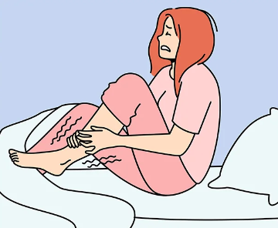
Introduction
Restless legs syndrome (RLS) or Willis-Ekbom disease, which is characterized by uncomfortable tingling sensations and an irresistible urge to move the legs.
It is also referred as nocturnal myoclonus, a movement disorder since patients feel a compulsion to continually move their legs to relieve their discomfort.

Slide 4
Etiology of RLS
In the majority of cases, the cause of RLS is not known.
Preliminary evidence suggests that some RLS sufferers have lower levels of iron in the brain, but iron supplementation is not considered to be an effective therapeutic option.
Journal of neurology,2020; 267(2), 575–577.

Slide 5
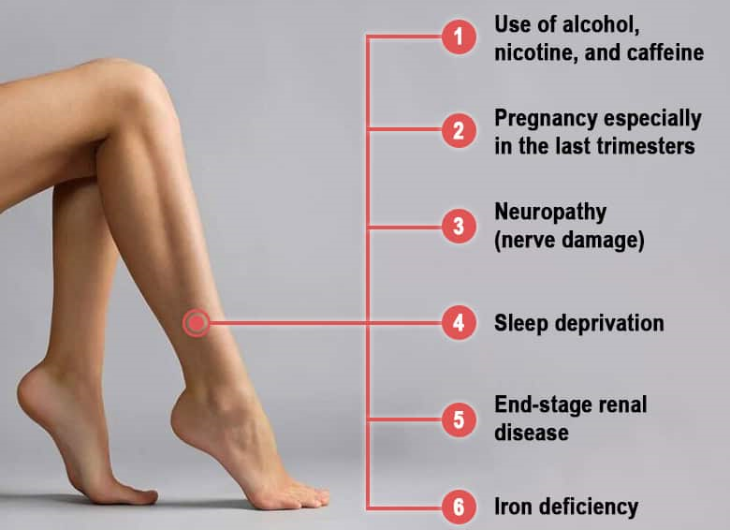
Etiology of RLS
Journal of neurology,2020; 267(2), 575–577.

Slide 6
Clinical presentations of RLS
At least 80% of patients with RLS also have a condition known as periodic limb movements, in which the limbs twitch or jerk during sleep, sometimes in repetitive, rhythmic patterns.^{1,2}
The movements often repeat at 15- to 40-second intervals.

Slide 7
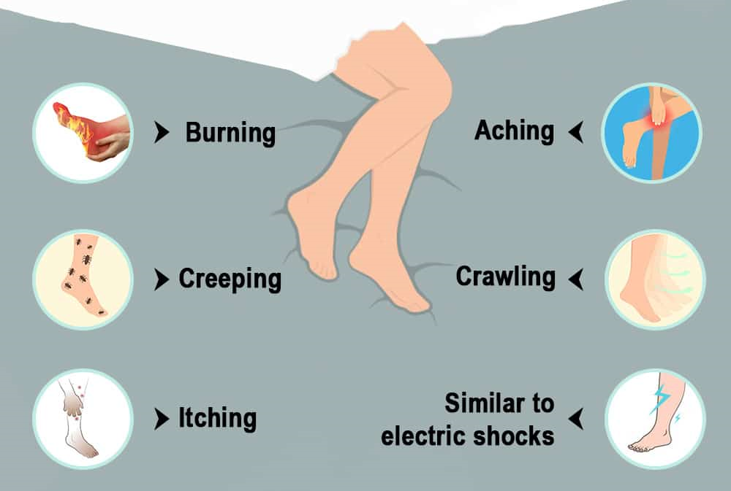
Clinical Presentations of RLS
Journal of neurology,2020; 267(2), 575–577.

Slide 8
Duration of symptoms
These sensations can last for an hour or longer, slowly increasing in severity.
While the sensations are most often bilateral, some patients experience them only on one side of the body.

Slide 9
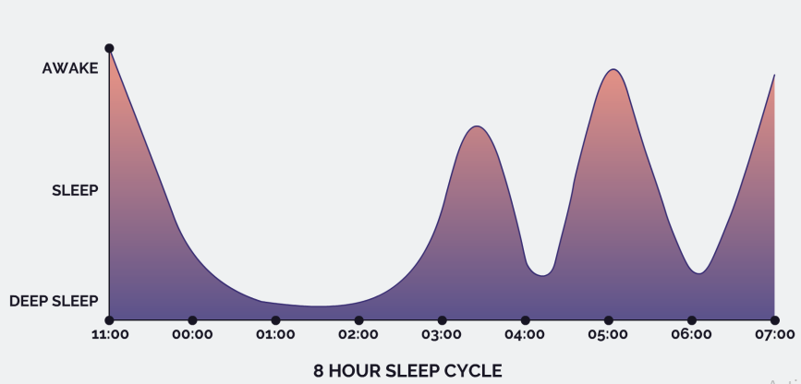
Sleep disturbances due to RLS

Slide 10
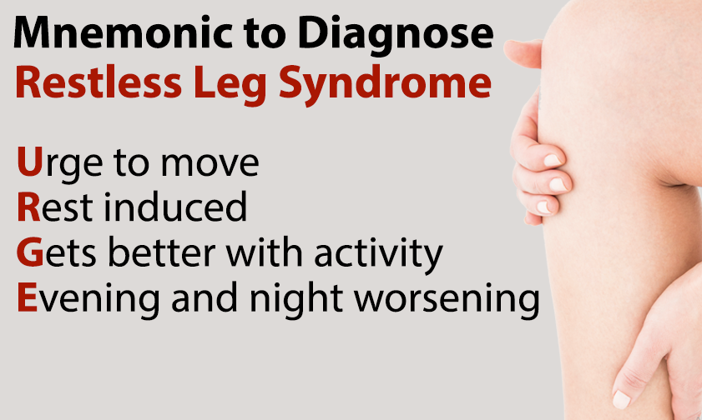
So, in RLS…

Slide 11

Diagnosis of RLS
Physicians may misdiagnose RLS as simple muscle cramps and/or wrongly attribute the symptoms to aging, nervousness, insomnia, stress, or arthritis.
RLS cannot presently be diagnosed by a specific confirmatory examination or test.

Slide 12
Diagnosis of RLS
Physical examinations and laboratory tests seldom find any abnormality.
However, they may uncover peripheral nerve disease and conditions with similar symptoms, such as iron deficiency anemia.²

Slide 13
Augmentation
Augmentation is the paradoxical worsening of RLS symptoms after prolonged RLS treatment that typically occurs in 10–68% of patients who underwent sustained treatment with dopamine agonists, usually after 3–10 years of effective management.
Sleep Med. 2016;21:1–11.

Slide 14
Augmentation
Augmentation risks are thought to be lower with use of smaller doses of longer acting dopaminergic agonists such as pramipexole and ropinirole, with rotigotine being the longest acting and having the lowest augmentation risk among these agonists.
Nature and Science of Sleep 2023:15 779–784

Slide 15
Pathophysiology of Augmentation
Although the mechanism for augmentation is unclear, it is thought to occur due to excess postsynaptic desensitization of dopamine 2 (D2) receptors in the substantia nigra and putamen with chronic intermittent dopaminergic stimulation.
Shorter acting dopaminergic agonists, such as levodopa, have the highest potential for augmentation developing with persistent use.
Curr Opin Neurol. 2010;23(4):401–406.
Sleep Med. 2016;21:1–11.

Slide 16
Questions to guide the diagnosis of augmentation
Do RLS/WED symptoms appear earlier than when the drug was first started?
Are higher doses of the drug now needed, or is it necessary to take the medicine earlier, to control the RLS/WED symptoms compared with the original effective dose?
Has the intensity of symptoms worsened since starting the medication?
Have symptoms spread to other parts of the body (e.g., arms) since starting the medication?
Eur J Neurol. 2022 Apr; 29(4): 1227–1231.

Slide 17
Management Challenges in Augmentation

Slide 18
Challenges in Augmentation
Augmentation is one of the most common and least understood problems encountered with RLS treatment.
Sleep Med. 2016;21:1–11.

Slide 19
Indications of Augmentation RX in RLS
Patient request for dose increase of a dopaminergic medication prescribed for RLS that previously was effective.
Reported breakthrough of RLS symptoms with an accompanying increase in symptom intensity and involvement of other body parts.
24-hour occurrence of symptoms.
Patient request for medication doses earlier in the day.

Slide 20
Plan of Augmentation RX
Current management recommendations include discontinuing the offending agent, optimizing sleep and sleep habits, or adding α2δ drugs or opioid therapy, but these latter options have significant potential side effects.
Sleep Med. 2016;21:1–11.
Chest. 2022;162(3):693–700.

Slide 21
α2δ drugs /Anti-Seizure Drugs
The α₂δ proteins are classically known as auxiliary subunits of voltage-gated calcium channels.
The α₂δ-1 and α₂δ-2 proteins represent the binding site for the gabapentinoid drugs gabapentin and pregabalin.
These drugs are often used for people who experience pain along with their other RLS symptoms.
These drugs are gaining popularity as an RLS treatment because they seem to work as well as dopaminergic agonists, but are less likely to cause augmentation of RLS symptoms.
  The FDA has approved gabapentin enacarbil for use in RLS, preferring it over standard gabapentin because it has fewer side effects.
  Another similar drug, pregabalin
The Annals of Pharmacotherapy, 2016;50(7), 586–591.

Slide 22
Opioids
Low-dose opioid medications are also effective in patients who have become refractory to first-line RLS treatments, particularly with augmentation to dopamine agonists.
Small studies have shown that these medications can control RLS symptoms over 2–10 years with minimal dose escalation.
Curr Neuropharmacol. 2021;19(3):372-382.

Slide 23
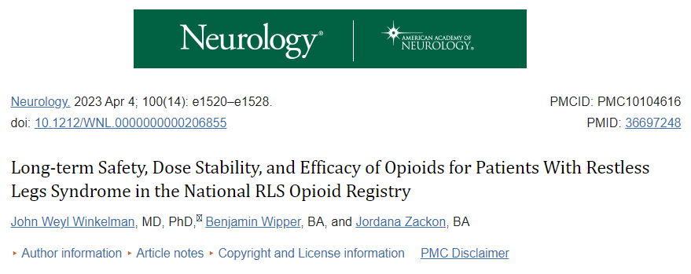
Low-dose opioid medications continue to adequately control symptoms of refractory RLS over 2 years of follow-up in most of the participants.
A minority of patients did see larger dose increases, which were invariably associated with a limited number of factors, most notably changes in opioid and nonopioid RLS medications and opioid use for a non-RLS condition.

Slide 24
Opioids
Methadone was the most prescribed opioids .
A large clinical trial with opioids was with oxycodone ER, methadone has become the standard treatment in refractory, augmented patients due to its long half-life and relatively lower risk of misuse due to once daily dosing and lack of euphoric effects.
For this reason, the few small long-term studies with opioids for refractory RLS have also all primarily used methadone.
Drugs. 2017;77(12):1337-1344.
Sleep Med. 2011;12(5):440-444.

Slide 25
Aripiprazole
Aripiprazole is a dopamine partial receptor agonist (DRPA) with intrinsic D2 and D3 activity in various parts of the brain acting as agonist.
Aripiprazole has been described in some case reports to be helpful for RLS, though worsening of RLS has also been reported.
Nature and Science of Sleep 2023:15
Drugs. 2017;77(12):1337-1344.

Slide 26
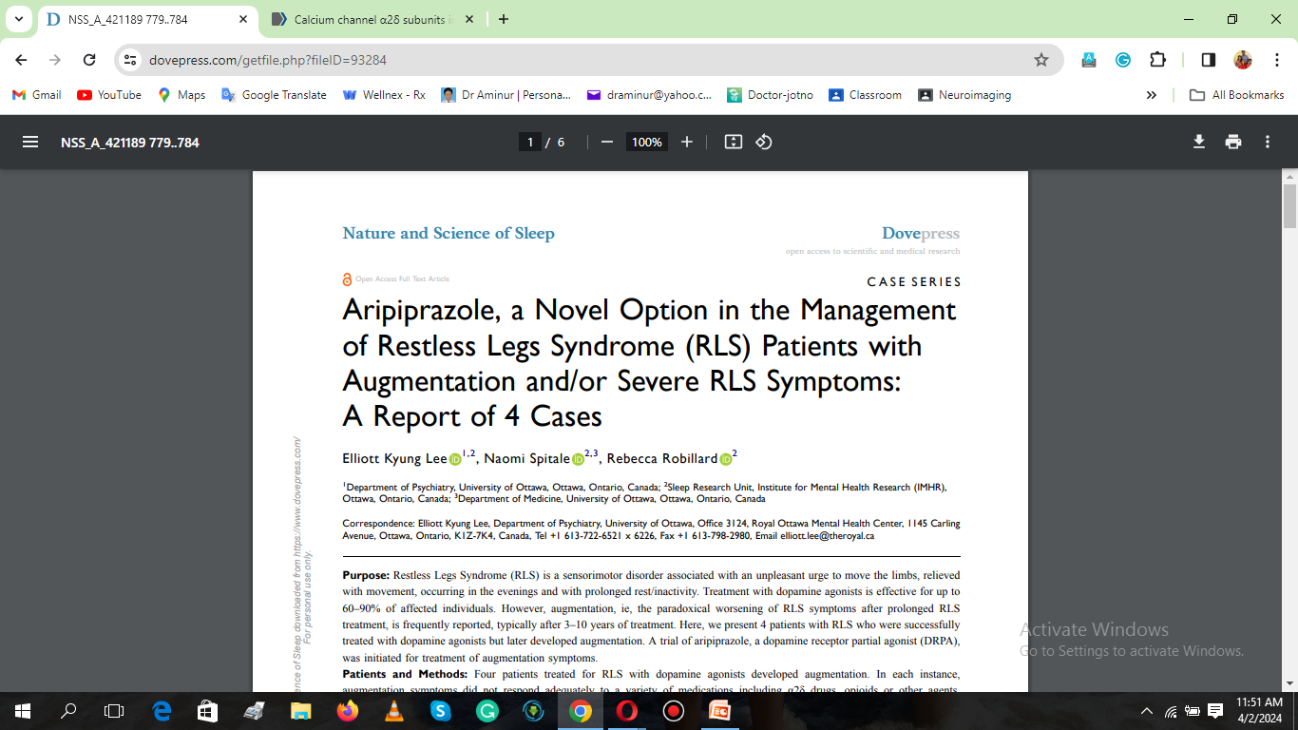
Augmentation in RLS is challenging to manage, and results in significant suffering for patients.
Aripiprazole, a dopamine receptor partial agonist (DRPA), may represent another option for management of augmentation in RLS given its unique pharmacological profile, but caution is warranted in interpreting these results given the significant medical and psychiatric complexities presented, as well as the number of medications these patients were using.

Slide 27
Benzodiazepines
Benzodiazepines don’t have a direct effect on RLS symptoms, but they may help individuals with RLS sleep more soundly.
Cochrane Database Syst Rev. 2017 Mar 20;3(3)

Slide 28
Other Drugs
A few substances, such as valerian and valproic acid, are sometimes used to treat RLS despite not being FDA-approved.
Neurology. 2016 Dec 13;87(24):2585-2593.

Slide 29
Deep brain stimulation (DBS)
Sleep Med. 2020 Dec;76:155-157.
DBS for RLS can be a new therapeutic approach for severe RLS,
DBS of the globus pallidus internus (GPi) has been reported to improve RLS symptoms in Parkinson's disease (PD) patients with RLS but further studies are needed.
Sleep Med. 2020 Dec;76:155-157.

Slide 30
Key Takeaways
Augmentation, a treatment-induced paradoxical worsening of the symptoms of restless legs syndrome (RLS) that is caused by long-term dopaminergic therapy.
The pathological mechanism behind this symptom is unclear and needs to be elucidated.
Recommendations of augmentation include discontinuing the offending agent, optimizing sleep and sleep habits, or adding α2δ drugs or opioid therapy and also ariprazole.

Slide 31


Thank you

